Slide 1

Consortium Harmonized Analysis Plan (HAP)
HeLTI
W Fraser MD
April 2023
Cape Town, SA

Slide 2
Trials are linked by our shared overarching objectives:
To assess, in different contexts, the effects of cumulative impact, health behavioral interventions on childhood growth and development, with the principal outcomes being childhood obesity/body composition at age 5.
To better understand the modifiable risk factors and their underlying mechanisms leading to childhood obesity, to make cross country comparisons, to validate find across countries and to identify sources of heterogeneity.
To create unique biobanks that will allow exploration of biological mechanisms

Slide 3
Background: Harmonization Efforts
Harmonized Protocols (for both phases 1 and 2)
Interventions targeting common domains
  nutrition
  maternal physical and mental health
  parenting skills and child development
  the home and social environment.
Measures : harmonized outcomes and co-variables
Consortium Harmonized Analysis Plan (HAP)
  Harmonized approach to analyses of individual trial results
  Consortium-wide approach to sharing of data for cross trial comparative and validation studies.

Slide 4
Country-Specific Analyses Protocols:
‘Hierarchical approach’ shared across the trials
Each trial will develop/publish an analysis protocol including:
1) pragmatic or ITT analysis for their primary outcome
2) harmonized, prespecified secondary outcomes, with correction of alpha for multiple comparisons,
2) all other secondary analyses, both in country-specific and across trials, to be considered as exploratory or hypotheses generating.

Slide 5
Data on treatment allocation status available sequentially, at end of each phase of follow-up
Preconception phase
Pregnancy Phase
Postnatal Phase (birth to 2 years)
Childhood phase (5 years)
NOTE: Analyses conducted on phase-specific intermediate outcomes will be considered as
exploratory or hypotheses generating

Slide 6
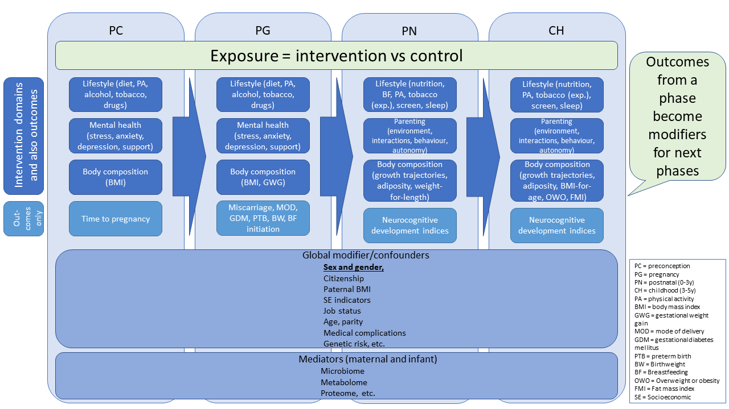

Slide 7
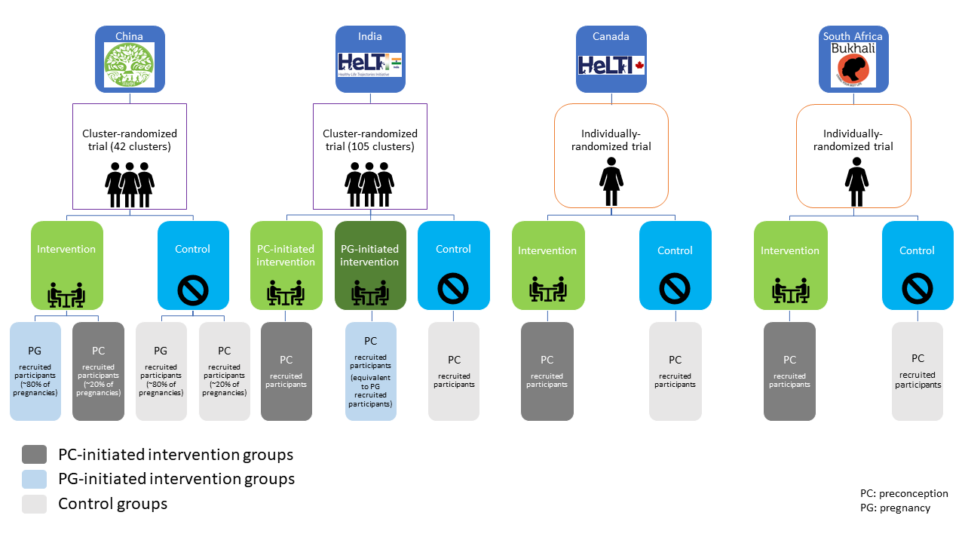
Challenges in cross-trial analyses: Design differences

Slide 8
Impacts of design differences
Very careful selection of groups for comparisons is essential
For meta-analyses (cross-country comparisons), differences in variance structures between simple and cluster randomization require special statistical approaches
    Individual patient data (IPD) (pooled) metanalyses are not recommended in this context
The preferred approach to meta-analyses across trials is to generate summary point estimates based on summary data from individual trials, and established methods to generate confidence intervals
Data sharing across trials will greatly facilitate meta-analyses, permitting rigorous adjustment for confounders in each dataset.

Slide 9
Simple versus Complex trials:
’Classical’ or hierarchical approach
  Goal is to minimize bias in estimating effects of the intervention on primary outcome
  Best suited to trials of simple interventions
  Trials of complex interventions justify the inclusion in the analysis of ‘complexity related questions’;
    Health administrators must make decisions as to whether or not to implement interventions, in which populations, and in which settings;
    It may be necessary to base decisions on less than ‘perfect’ evidence; ie. evidence that is generated in simple (drug) trials

Slide 10
‘Complexity related’ questions: Examples
How do the components of the intervention work alone and in combination to produce effects?
How and why does the implementation of the intervention vary across contexts?
How does the system change when the intervention is introduced?
What are the effects (anticipated and unanticipated) which follow from this system change?
How do effects change over time? (Changes may relate to biological, ecological, epidemiological or social factors)
What explains how effectiveness of the intervention changes over time?
What factors enable or inhibit implementation of interventions?
What changes in processes and outcomes follow the introduction of this system change?
REF: Booth A, Noyes J, Flemming K, et al. Formulating questions to explore
complex interventions within qualitative evidence synthesis. BMJ Glob Health 2019;4:e001107. doi:10.1136/ bmjgh-2018-001107

Slide 11
Approaches to Prioritizing questions:
Importance of involving stakeholders - WHO
  Networks of HeLTI researchers
  Health programme deciders (hospital and clinics administrators, regional / provincial/national deciders)
  Clients (women of reproductive age, partners, families)
  Each group may have their different priority knowledge gaps, with some expected overlaps, ie. Programme cost/benefit analysis may a higher priority for Health programme deciders that to clients.

Slide 12
Approaches to involving prioritizing research questions
Delphi groups
Surveys
Informal consultations
Collaboration with existing groups with expertise in priority setting : ie. James Lind Alliance – NIHR (UK) (Client and clinician priorities)

Slide 13


Slide 14
Importance of Working Groups in prioritizing questions
Early Child Development
Biospecimens and Basic Science Research
Adversity
Genotyping
Microbiome

Slide 15
Data access mechanisms
SCHeLTI project

Slide 16
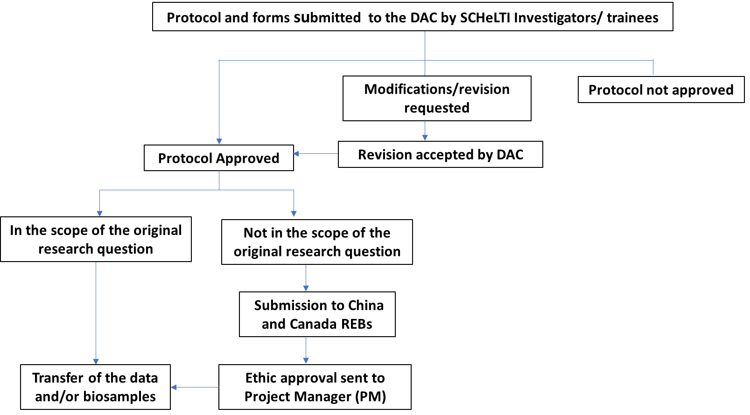
DATA access process for SCHeLTI researchers

Slide 17
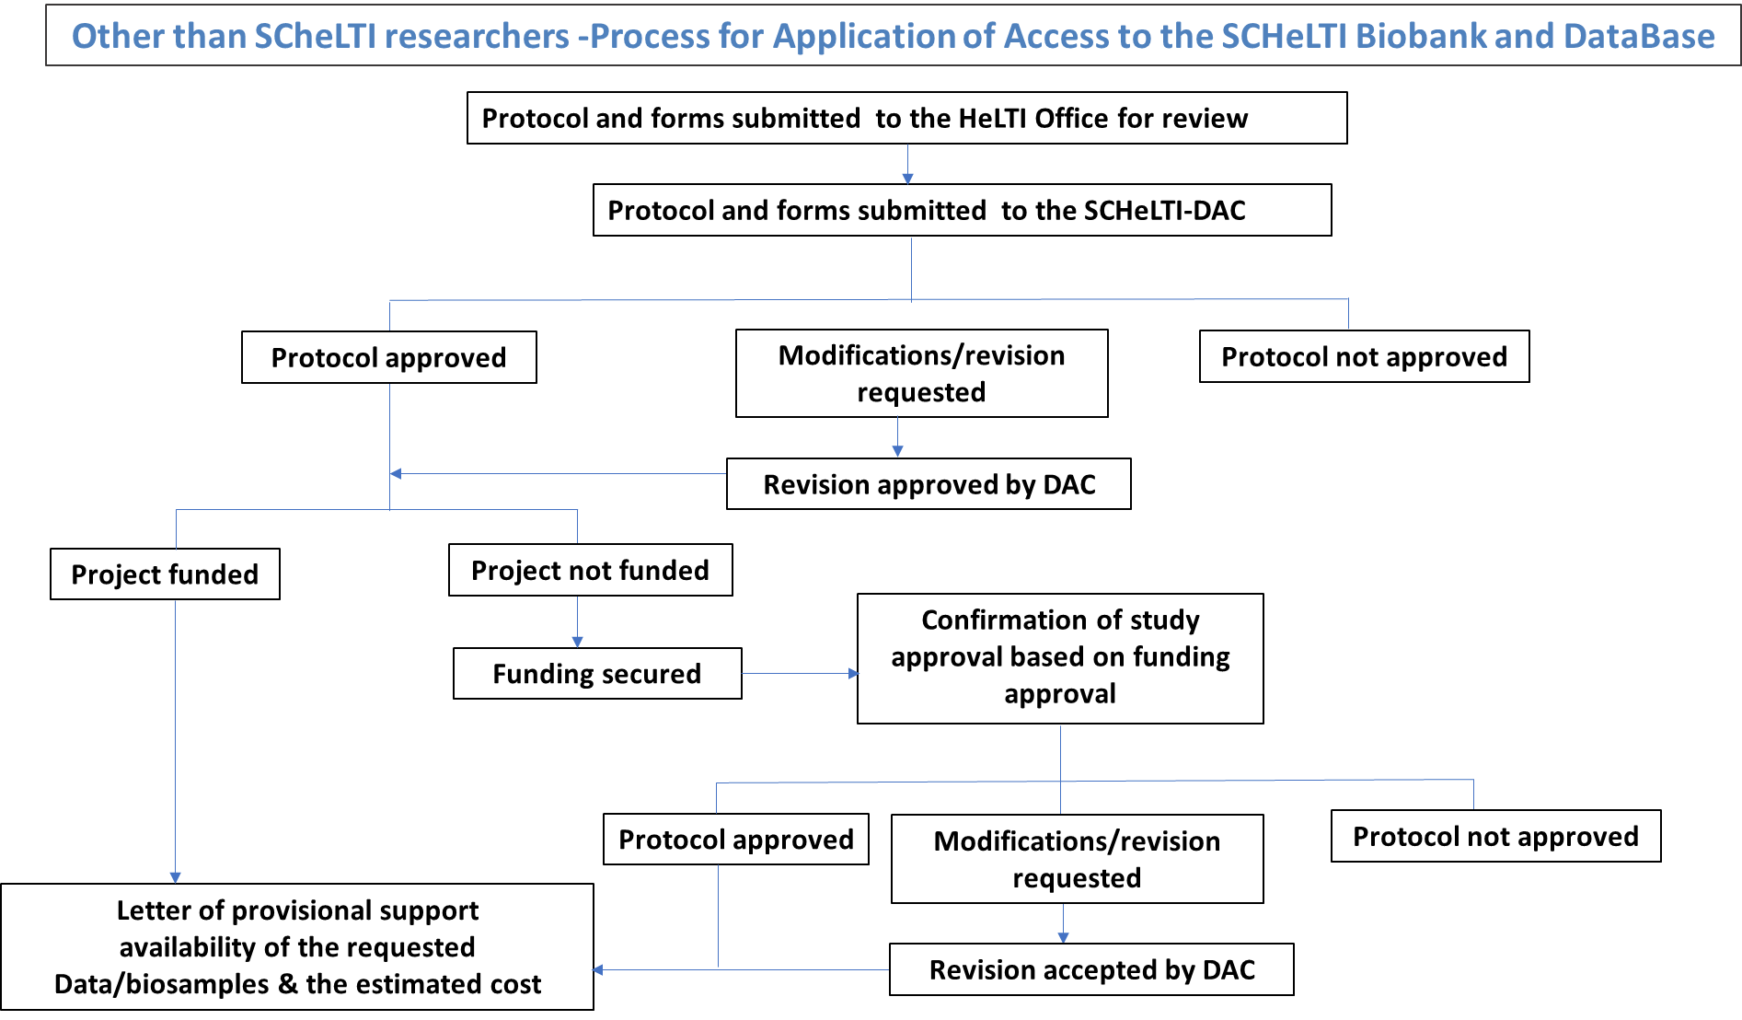
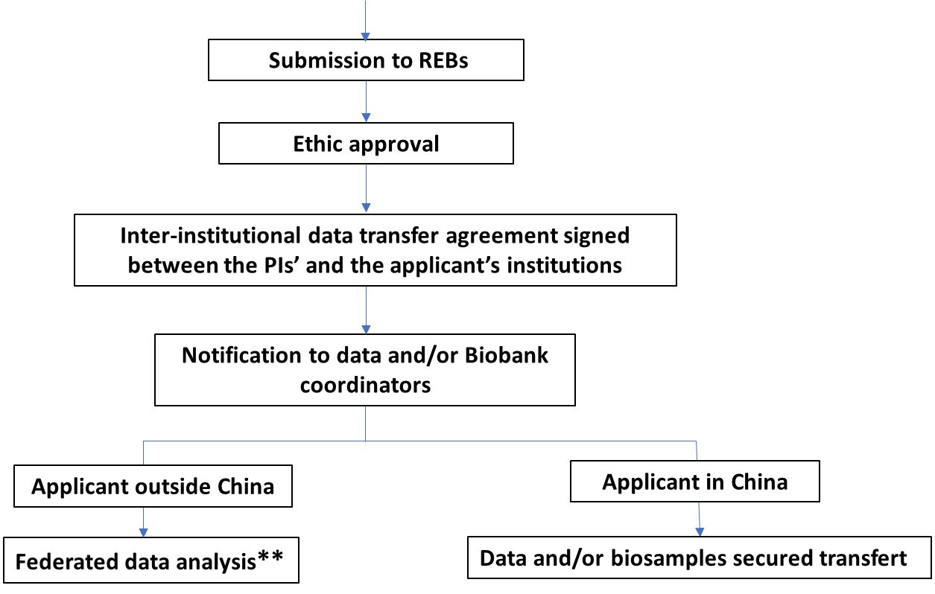
DATA access process for other than SCHeLTI researchers
* *Once regulatory approval has been given for the sharing of individual patient data with Non Chinese applicants, the denominalized dataset containing individual patient data will be encrypted and sent to the applicant

Slide 18
Spreadsheet of the Domains
Domains | instruments | Researcher implicated in the development of the sections of the CRFs
Mother–child interaction | Attachment (observational/questionnaire) | C, Herba, L Booij, Fraser, Xu Jiang, Guanghai Wang, ZC Luo, Ouyang F.
Child neurocognitive development | Ages and Stages questionnaire
 | Neurodevelopment (Wechsler)
 | Executive function
 | Language Development
 | Temperament/behaviour
category of outcome | Variable of interest/outcome | Period PC=Preconception PG=Pregnancy CH1=Early childhood period (0- <3y) CH2=Infancy period (3y-5y) | Method of analysis (ex. linear regression, logistic regression, survival analysis, repeated measures analysis, etc.). Details on the proposed research question | Statement of interest for this domain of analysis (names)
Maternal Cardiometabolic | Weight/BMI variation in preconception | PC and early PG
Maternal Cardiometabolic | Pregnancy weight gain (Conformity or not with IOM Guidelines) | PG
Maternal Cardiometabolic | Gestational Diabetes Hypertensive disorders of pregnancy | PG
Maternal Cardiometabolic | Blood pressure | PC, PG, CH1, CH2
Maternal Lifestyle | Diet and related variables (DQI, FFQ, etc.) | PC, PG

