Slide 1

HEALTHY LIFE TRAJECTORIES INITIATIVE (HeLTI)
Capacity Building

Slide 2

CAPACITY BUILDING FOR ECRs
Training, network, infrastructure and mentorship of ECRs
^{Scientific programme leader:}
^{Professor Shane Norris}
Recruitment
Integration
Promotion
^{Scientific programme leader:}
^{Professor Shane Norris}
Notes:
A key part of CB is recruitment and integration of ECRs. To do that we provide training, network, and mentorship possibilities for ECR., to prepare them for leading furture HeLTI projects and spearhead upcoming grant applications, and enhance long-term sustainability,
In the next few mins, we use the term ECR broadly .. This includes…
58 people number still growing

Slide 3
HELTI ECR/TRAINEE SURVEY
CAPACITY BUILDING FOR ECRs
What are the needs of ECRs?
How likely are ECRs to participate in organized activities?
Development and administration of a survey
Survey inspired by one created by DOHAD-ECR group, adapted to the HeLTI context.
Notes:
To get a better sense ofwhat tpe o0f capacity building we need to do for ECR, 3 question are important here”
Whe developing capcait building for ECR, 3 things are impoirnat here
HeLTI’s membership demographics, as well as the interests of early career researchers and trainees working on HeLTI-related projects, we developed an online survey, to discover how trainees and early career researchers (ECRs) would prefer to engage with HeLTI over the next 5 years.
n=15 – 28 depending on question

Slide 4
%
65% females
3–4 days/week on HeLTI projects
Notes:
N=15-28
You will find the details of the survey in the report. E.g. of particular interest for ECR were webinars., website with resources, international summer school and exchange programs.
Informal membersbip, website with resources, and exchange and intern summer school programs.
We had representation of difernt coutnir
40% cnd
40% SA
13 china
2 india
60% Canada, SA,40% india and China

Slide 5
What kind of activities would you like to see developed over the next five years?
Percentage
Notes:
Here you see what kind of activities
Vertically, the activities, horinzontalu, % of ECR that wants to see a certain act developed. Fgreen bare what they are most interested in.
ECR are particularl interested in webinars, website with resources, summer school and ST exahnges

Slide 6
How likely are you to participate in any of the following activities?
Percentage

Slide 7
INTEREST AND LIKELINESS OF PARTICIPATION (COMBINED DATA)
Ranking | Activity
1 | Website with resources. ✅
2 | Webinars ✅
3 | International summer school Short-term exchanges
4 | Informal mentorship ✅
5 | Online peer reviewed courses
6 | Formal mentorship
7 | Interactive online platform
8 | Online networking
Notes:
We then used the answers of these 2 questions to know which actuvitiwes are of interest AND people are likely going to be engaged in. we did that b compulting a weighted summed score and based on the score ranked them in order of importance according to ECRs.
4 activities stood out and had almost equally high scores, so equally importance.
Obviously an ECR CB activity is only important when people say theyt are interested but also will be attending.
So we combine data from the previous 2 slides and then came up with a summed score, and raked them according to the ECRs preferences.
Rank 1-4 very close together, others less of interest compared to 1-4
webinars: mid career , connect
deligate : consorium resources, websites/webinars, long -term: exhange/summer etc
bold;
checkmars /
n
informal : build in , copmntinues to grow

Slide 8
PREFERRED STRATEGIES
Notes:
When further asking about engagement strategies; they seem to value in particular information coming from Pis and other senior researchers,
Support strategies for women in science and strategies for trainees and ECR from underrepresented groups is also important, something we have not yet tapped into in terms of capacity building

Slide 9
LESSONS LEARNED SO FAR
HeLTI ECRs are interested in and will most likely make use of online resources, webinars, in-person international summer schools/exchanges, and informal mentorship.
ECRs favour educational opportunities taught by senior / mid-career leaders
ECRs are relatively less interested / likely to participate in activities for which the primary focus is on interacting with peers.

Slide 10
TRAINING AND DEVELOPMENT OPPORTUNITIES
Creation of a monthly ECR webinar series
  Open to HeLTI members and non-members
  To create possibilities for ECRs to present their research
  New: Webinars given by mid career -and senior researchers (including but not limited to) PIs.
  Well attended
Notes:
One of key activities in terms of capacity building are the montly webinar series.
Initialy the idea was that only ECR or mid career woiuld talk and present theu rowkrl, but what we have learned that they particular value talks from more senior researchers.

Slide 11
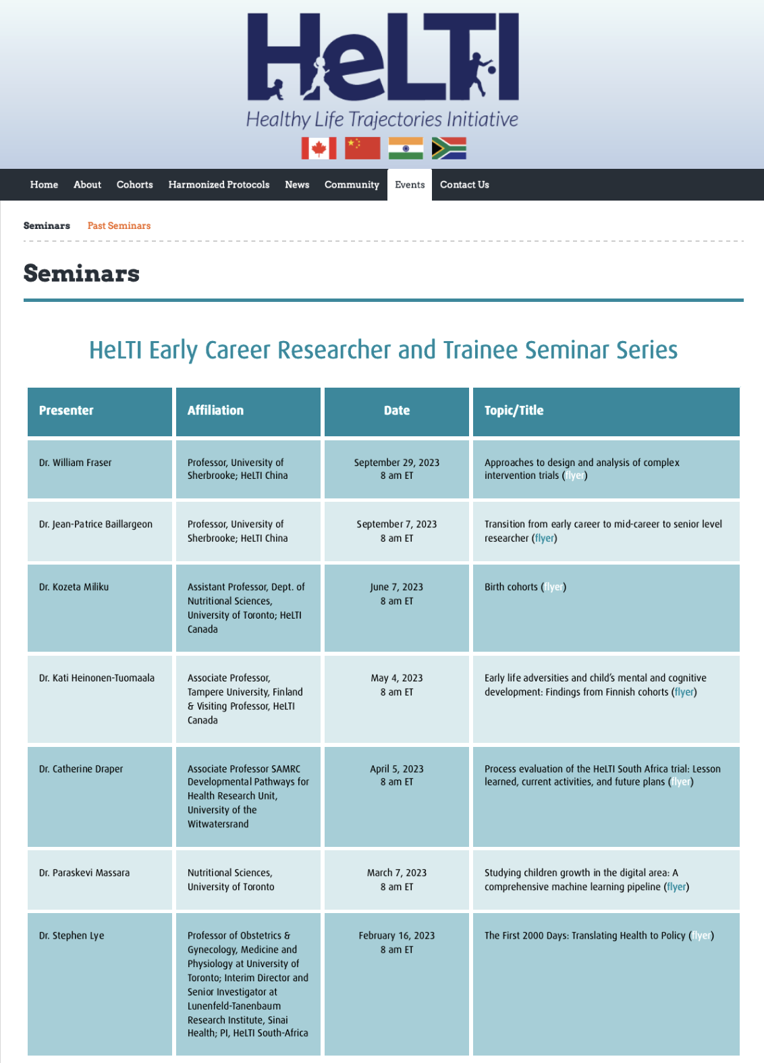

Slide 12
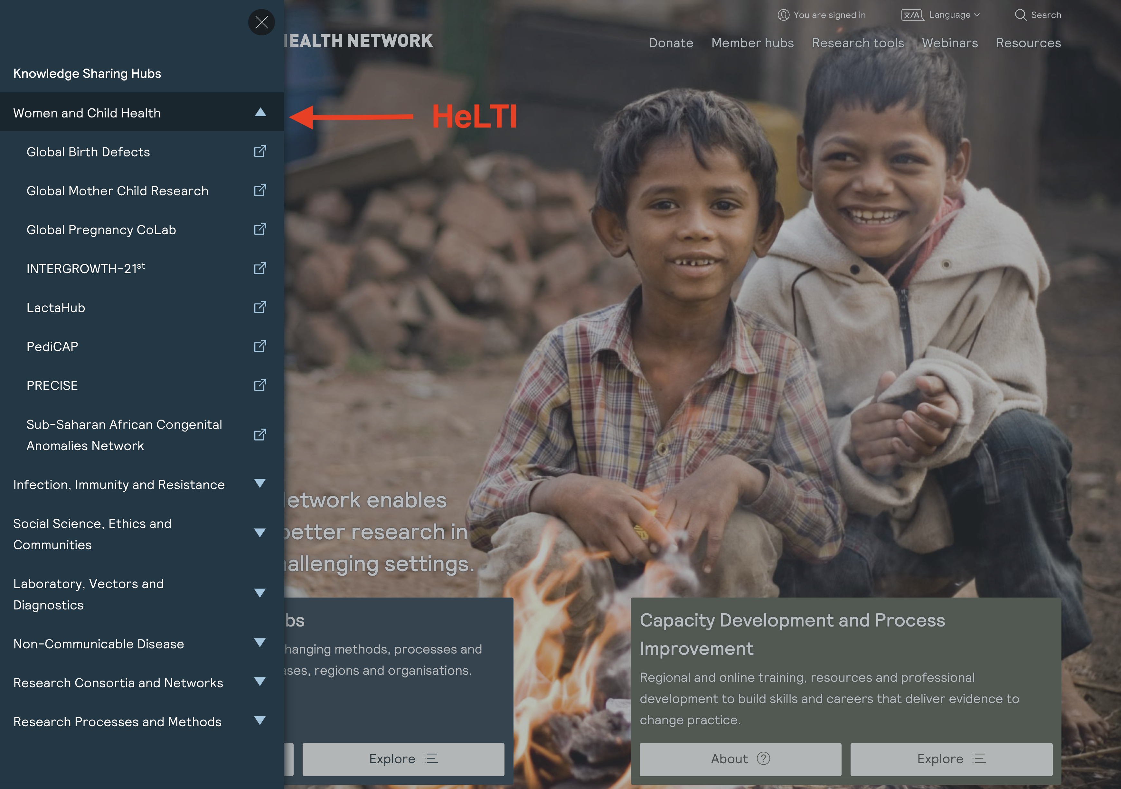
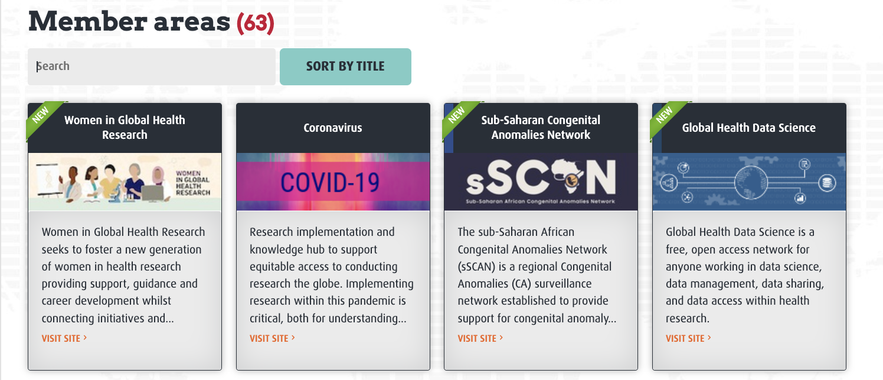

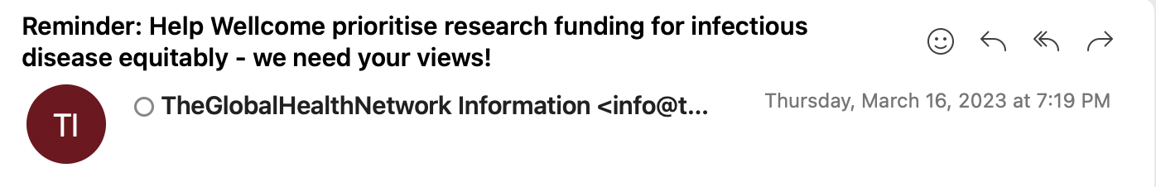
CREATION OF ONLINE RESOURCES
Member’s Hub
The Global Health Network is a collection of online research communities located together on a shared digital hub.
Launching of the website
Social Media
Email List
Notes:
A majpr actvit in terms of capacity building is website with resources. To do this, we are part of the global health network.

Slide 13
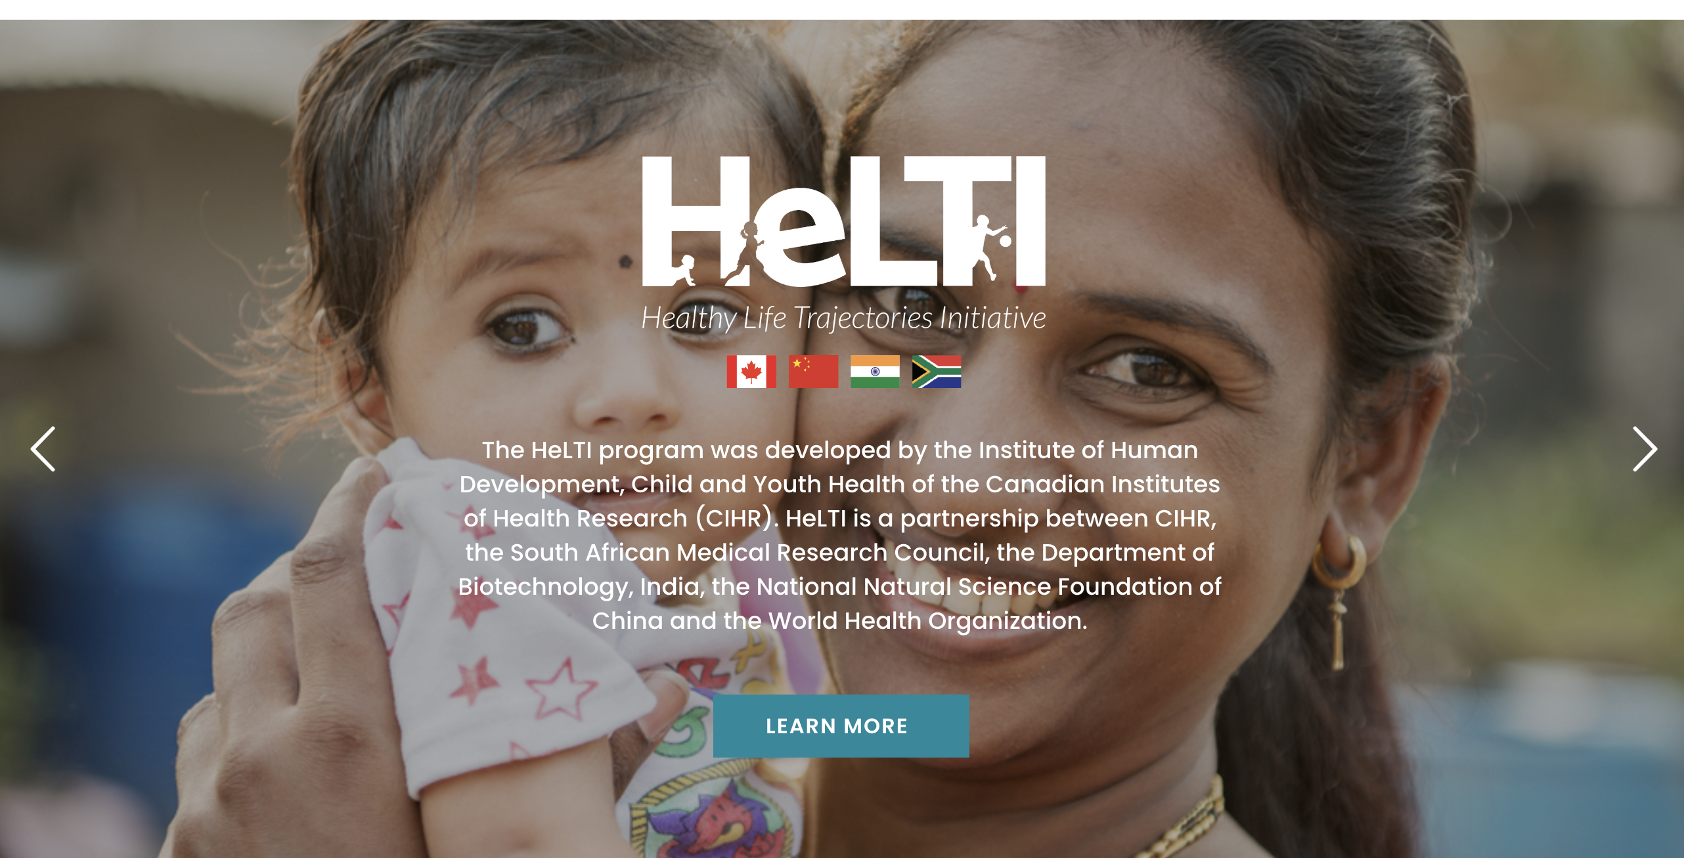
GLOBAL HEALTH TRAINING CENTRE
Allows access to online resources and courses developed by international experts
HeLTI Hub
Aim: support engagement, dissemination and training for HeLTI members and partners and to exchange resources and knowledge.
Notes:
with training platforms on topics of interest to HeLTI members. Linkage with the Global Health Training Centre (hosted by TGHN) allows access to courses developed by international experts. We are finalizing the HeLTI Hub, which will support engagement, dissemination and training for HeLTI members and partners. This platform will also allow HeLTI to exchange resources and knowledge and foster links with the larger TGHN network, thereby increasing visibility and impact of HeLTI.

Slide 14
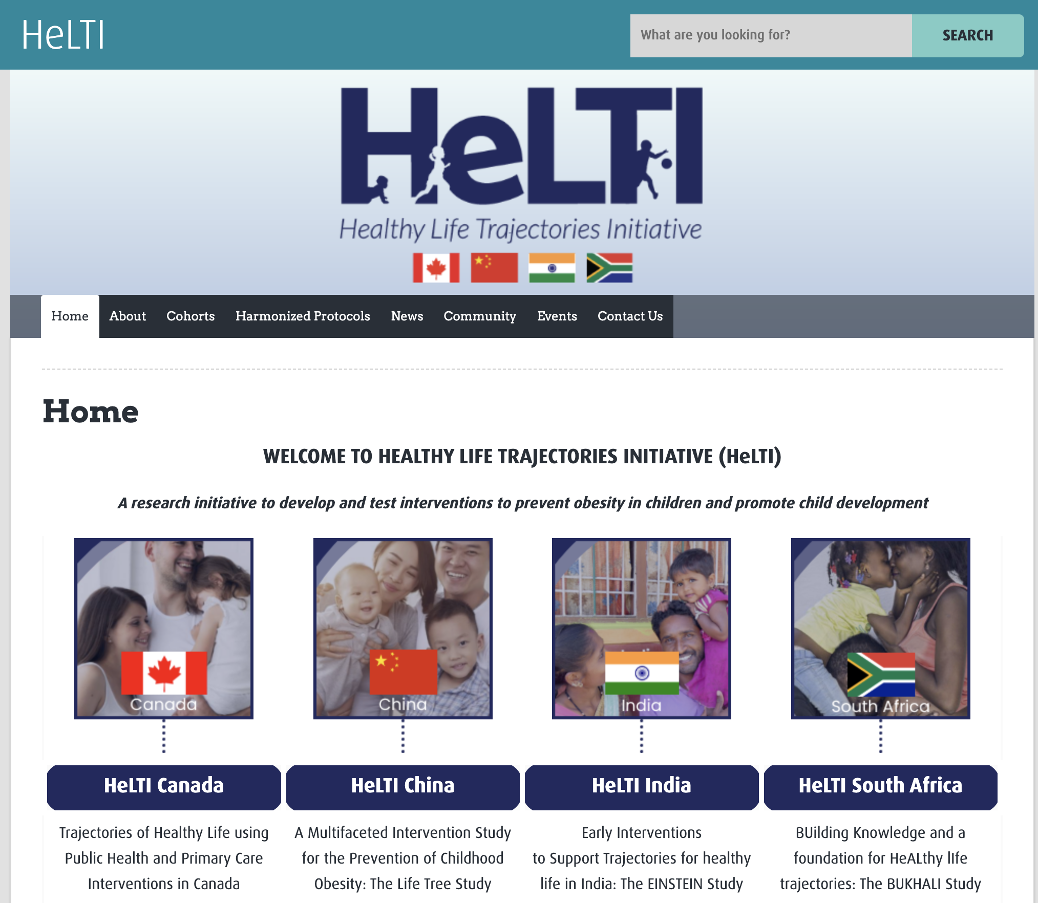
https://helti-hub.tghn.org
Notes:
Has been launched this week, and will continue to expand.
This platform will also allow HeLTI to exchange resources and knowledge and foster links with the larger TGHN network, thereby increasing visibility and impact of HeLTI.

Slide 15
WORK IN PROGRESS
Continued engagement by ECRs across HeLTI teams:
Meet the PI event (planned for late 2023)
  Use of a ”bottom-up” approach when developing initiatives (led and created by ECRs).
  Expanding mentorship
  Forming partnerships with other networks.
  Interest in larger-scale initiatives (e.g., summer school; exchanges across consortia). Funding has not been secured.
  Capacity building important for promoting sustainability and succession planning.
Notes:
The launch of the webinar and the helti hub are key activities to increase capacity. We further planning to continue engagement b ECR by creating other events, such as an event where ECR and Pis come together to develop initiatives and to promote further mentosship. We also are creating partnerships with other networks such as enrich and dohad.
In line with the results of the survey about the interests of ECR, I showed before, we are interested to develop formal exchanges and summer schools. But unlike other actviteis we do that at a slower speed,. We are still looking into the feasialbilit since funding has not yet been secured.
All in all, with these ECR activities, we hope to increase the number of and level of engagement of ECR,
Considering the amount of data and biospecimc available in the ears to come and other psosobolities witin heltu . this creates unique research possibilities for them,
With further capacity building we are also being able to promote sustainability and securing succession in the long run

