Slide 1

HEALTHY LIFE TRAJECTORIES INITIATIVE (HeLTI)
Consortium Update

Slide 2

Output Summary
13,107
participants enrolled
136
Publications in review/press/print
^{Scientific programme leader:}
^{Professor Shane Norris}
$ 6,886,595 CAD
funds
leveraged
61 students/postdocs supported
^{Scientific programme leader:}
^{Professor Shane Norris}
737,143
biosamples
collected
295
research associates/field staff

Slide 3
Governance Framework
  Completed the International Governance Framework
    National data sharing policies are monitored and changes, if any, will be integrated into the Framework
  Recognize the importance and value of the Governance Framework, as we engage with the wider community
^{Scientific programme leader:}
^{Professor Shane Norris}

Slide 4
Continuous Harmonization / Collaboration
  Continued work of working groups (Biospecimens; Data Management and Quality Assurance; Interventions and Retention; ECD; Capacity Building; Publications)
  Harmonization working group ongoing: 1925 core variables are harmonized facilitated by Maelstrom (https://www.maelstrom-research.org)
  Early Child Development: suite of harmonized tools developed to assess trajectories of neurodevelopment
  Intervention fidelity protocol developed and implemented
  Harmonized HeLTI template for Quality Assurance Monitoring (WHO): DMC
  Planning development of KT Advisory Committee
^{Scientific programme leader:}
^{Professor Shane Norris}

Slide 5

Data Collection
Not in South Africa
^{Scientific programme leader:}
^{Professor Shane Norris}
Sequential process of harmonisation
8-10 Data collection waves

Slide 6
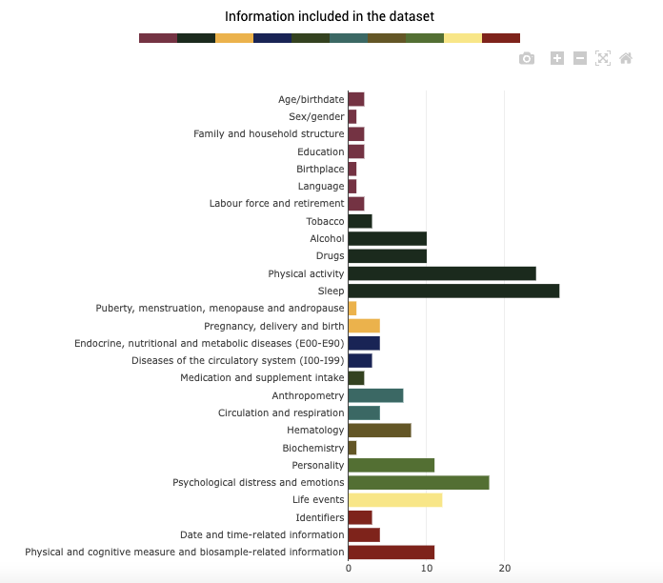

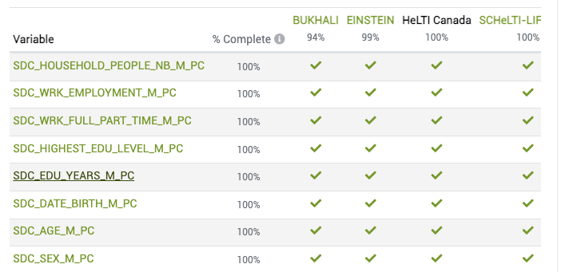
Catalogue of Harmonized Variables
@
https://www.maelstrom-research.org
^{Scientific programme leader:}
^{Professor Shane Norris}
Notes:
Maybe we can put this slide here instead? (but fell free to move it up where you had it)

Slide 7
Continuous Harmonization / Collaboration
  Continued work of working groups (Biospecimens; Data Management and Quality Assurance; Interventions and Retention; ECD; Capacity Building; Publications)
  Harmonization working group ongoing: 1925 core variables are harmonized facilitated by Maelstrom (https://www.maelstrom-research.org)
  Early Child Development: suite of harmonized tools developed to assess trajectories of neurodevelopment
  Intervention fidelity protocol developed and implemented
  Harmonized HeLTI template for Quality Assurance Monitoring (WHO): DMC
  Planning development of KT Advisory Committee
^{Scientific programme leader:}
^{Professor Shane Norris}

Slide 8
Data Management and Quality Assurance
  Draft SOP for data sharing and analysis across the consortium prepared
  Consortium level harmonized analysis plan to be applied across the 4 studies has been developed
  Analysis plan will allow HeLTI to compare intervention effects across the 4 regions
  Sex and gender champions and economists engaged
  HeLTI investigators asked to identify analyses of interest
^{Scientific programme leader:}
^{Professor Shane Norris}

Slide 9
Biospecimen Working Group
  Meeting on a monthly basis
  Ongoing monitoring of collection and processing SOPs
  Quality Control Strategy (DNA / RNA)
  Developed harmonized biospecimen reporting system
  Continue to work with external consultant: Donna Russell supported by WHO
  Development of analytic platforms rather than biospecimen distribution (e.g. Proteomic / Genetic / Epigenetic)
^{Scientific programme leader:}
^{Professor Shane Norris}

Slide 10
Capacity Building
Goals:
  Recruitment, integration, promotion ECRs
  Development of mentorship program
  Creating training and development opportunities
2022
  Supported ~60 ECRs
  Highly successful webinar series (~50 participants / session): focus ECR presentations
  Administered survey to understand ECR needs
  Developing ‘meet the PI’ event
  Future Exchange program / Summer school
^{Scientific programme leader:}
^{Professor Shane Norris}

Slide 11
Sex and Gender Based Principles (SGBP)
  HeLTI SGBP: generate, understand and apply evidence related to sex and/or gender-related factors for improving child health and preventing NCDs
  Domain #1: Study design and methods
  Domain #2: Analyses
  Domain #3: Knowledge translation
  Domain #4: Partnerships and patient / public involvement
  SGBP framework finalized, S&G Champions engaged
  Execution site-specific
^{Scientific programme leader:}
^{Professor Shane Norris}
Notes:
Describe any changes to how the HeLTI collective has considered sex or gender in any of the approaches. (maximum 300 words)
CIHR recommends studies consider sex as a biological variable in basic science, clinical, health system and population health studies and gender as a sociocultural determinant of health in the clinical, health system and population health studies where appropriate. The HeLTI consortium’s Sex-and-Gender based analysis (SGBA) strategy aims to generate, understand and apply evidence related to sex/or gender-related factors for improving child health and preventing non-communicable diseases (NCDs). The objective will be to integrate the SGBA into four program domains.
Domain #1 – Study design and methods
This domain includes: embedding sex and gender in the design, maternal factors in child health and the role of fathers/partners, including the genetic/epigenetic and environmental factors, different incidence or prevalence based on sex; how sex and gender in data collection; inclusion and recruitment methods and mitigate gender bias; and, intervention team SGBA training and capacity building.
Domain #2 - Analyses
This domain examines how sex and gender are measured and analyzed by: disaggregating data by sex; statistical analysis to assess the effect or association of sex and gender; primary outcome stratified by sex and gender; analyzing the data by sex and gender differences and similarities; and how gendered sub-groups are linked; and separate sex and gender reporting in the results.
Doman #3 - Knowledge Translation
Knowledge translation plans integrate sex and gender by choosing the messengers, disseminating and crafting messages; addressing "gender gaps" in policies and systems; considering sex and gender in KT products; and aligning publications and gender-related results; with SGBA reporting guidelines–e.g., SAGER
Domain #4 –Partnerships and Patient/Public Involvement
Ensure that sex and gender are represented in developing partnerships for policy, including sex and gender in advisory committee composition and patient and public involvement.
Progress To Date: A SGBA protocol has been drafted by HeLTI Canada for the consortium and each HeLTI team has identified a Sex and Gender Champion for their trial. These individuals have all received training and will review the HeLTI studies according to the four outlined domains and provide a summary of recommendations and areas for modification or planning for each trial. This data will be consolidated, and a Sex and Gender meeting will be convened with champions and PIs for next steps.

Slide 13
HeLTI @ DOHaD2022 Vancouver
  Research Committee Meeting
    Knowledge Mobilization: Melanie Barwick
    Integrating knowledge Translation: Linda Li
  HeLTI Workshop
  HeLTI Symposium
    HeLTI Consortium
    Indigenous HeLTI
  Multiple HeLTI Oral and Poster presentation: HeLTI visibility
  DOHaD Canada trainee involvement
^{Scientific programme leader:}
^{Professor Shane Norris}

Slide 14
HeLTI Workshop
  Engagement and Update of HeLTI Investigators
  65 Participants
  Break-out groups: New Research
    Preconception health
    Pregnancy complications
    Mental health
    Cardiometabolic health
  Involvement of ECRs
  Well-attended evening reception
^{Scientific programme leader:}
^{Professor Shane Norris}

Slide 15
Economic Evaluation
  Site-specific discussions, engagement with health economists ongoing
  Consortium wide meeting: June
  Decisions around strategy, harmonization
  Analysis by phase
^{Scientific programme leader:}
^{Professor Shane Norris}

Slide 16
Knowledge Exchange / Engagement
  DOHaD 2022
  Trainee program @DOHaD2022: involvement of HeLTI trainees
  HeLTI lead investigators invited to present the HeLTI study
    Translating DOHaD Science to Intervention: University of Cambridge, UK
    The Science of Nurturing Care; International convention on Public Health, Havana, Cuba
    An intergenerational life-course approach to address early childhood obesity and adiposity: the Healthy Life Trajectories Initiative (HeLTI); Lancet Global Health Conference
^{Scientific programme leader:}
^{Professor Shane Norris}

Slide 17
Integrating Knowledge Translation
  Linda Li UBC and Nigel Rollins WHO
  Session with all HeLTI teams represented
    How should HeLTI engage key stakeholders and socialise the concepts of DOHaD / HeLTI?
    What additional activities might HeLTI build into projects to deepen opportunities for knowledge translation?
    What are realistic KT objectives for HeLTI?
    How should HeLTI determine which activities to initiate or participate in?
    Where does the HeLTI consortium see its strengths and gaps to achieve its KT goals?
^{Scientific programme leader:}
^{Professor Shane Norris}

Slide 18
Mechanistic Science
  Number of funded grant leverage HeLTI
  A number of new ideas emerged at HeLTI workshop
  Extended Research Committee to meet in November to discuss science
  Steve Lye
^{Scientific programme leader:}
^{Professor Shane Norris}

Slide 19
Data Monitoring Committee
Single DMC Committee for all 4 trials
  Composition: 5 members and Chair; each with extensive trial, DMC, content expertise; WHO rapporteur
  Single Charter, updated over time with RC and DMC
  Harmonized templates for open and closed reports
  Review and discussion of progress, as per established DMC Terms of Reference
  Recommendation letters provided with feedback
^{Scientific programme leader:}
^{Professor Shane Norris}

Slide 20
Data Monitoring Committee Meetings
  June 2019 – initial presentations of trial design and approval of the DMC Charter
  November 2021- the DMC advised continuation without any changes for all 4 trials… The DMC congratulates all four HeLTI teams of investigators and staff for their brilliant progress and productivity despite the challenges of the COVID-19 pandemic….Overall, data collection and completeness, and compliance and adherence to study protocols across the four studies is very good to excellent. The DMC had no safety concerns with respect to any of the four studies
  April 2023 –open and closed meetings completed; recommendations pending.
^{Scientific programme leader:}
^{Professor Shane Norris}

Slide 21

Conclusions
  Governance
  Harmonization
  RCT protocols
  Unblinding protocol
  Sex and Gender framework
  Consortium-wide analysis plan
  New interactive website launched
^{Scientific programme leader:}
^{Professor Shane Norris}

Slide 22
Publications: Impact
Publications
^{Scientific programme leader:}
^{Professor Shane Norris}

Slide 23
Challenges
  Data Sharing: meeting country regulations
  Biospecimen analysis
  Infrastructure for consortium-wide data management
  Optimizing the impact of unique and valuable cohorts
  Endpoint of trials will extend beyond the end of the current funding cycle
^{Scientific programme leader:}
^{Professor Shane Norris}

Slide 24
Opportunities
  Longer-term follow-up (after 5 years)
  Child development outcomes / school performance
  Family level data (partners / sibling)
  Training programs
^{Scientific programme leader:}
^{Professor Shane Norris}

Slide 25


Slide 26
Data Monitoring Committee
DMC Charter Highlights
  Aim- safeguarding the interests of study participants and assuring the integrity and credibility of the HeLTI trials.
  Provides recommendations to the Trial Executive Committee
    Quality and performance of the study
    Safety and adverse events
  Established processes for Decision making and Reporting
^{Scientific programme leader:}
^{Professor Shane Norris}

