Slide 1
HeLTI Council Meeting
April 2023
Cindy-Lee Dennis, PhD, FCAHS
Professor in Nursing and Psychiatry, University of Toronto
Senior Scientist, Lunenfeld Tannenbaum Research Institute, Sinai Health
Research Chair in Women’s Health, Unity Health Toronto/St. Michael’s Hospital
Catherine Birken MD, MSc, FRCPC
Professor, Department of Paediatrics, University of Toronto
Scientist, Child Health Evaluative Sciences, SickKids Research Institute
Edwin S.H. Leong Chair in Child Health Interventions, University of Toronto

Slide 2
HeLTI Canada Overview
Sample Size | 5230
Study Population | All pregnancy-planning women, their partners, and “sibling child” if applicable
Setting | Across Canada
Study Design | 2-arm trial - women are randomly allocated in a 1:1 ratio to the 4-phase intervention or usual care
Study Intervention | Individualized, technology-based collaborative care provided by public health nurses trained in healthy conversation skills

Slide 3
Our Primary Focus Has Been Recruitment

Slide 4
Recruitment Timeline
January 2021
REB only allowed recruitment by social media
March 2022
Lockdown ended in Toronto
Decision to develop new recruitment strategy
October 2022
REB Amendments
Launched trial during pandemic
Initiate face-to-face recruitment
Recruit any pregnancy-planning woman
Recruit all across Canada

Slide 5
COVID IMPACT
Delayed trial launch
Complete loss of recruit strategy
End contracts with hired and trained research staff
Loss public health nurses to covid deployment
REB amendments still ongoing
Canada had some of the strickest lockdown polies internationally which lasted the longest - especially Toronto – last lockdown ended March 2022
Impact of health outcomes of Canadians and children
Mental health, lower child immunization rates, child development
Canada’s ranking for infant mortality has fallen - 30/38

Slide 6
New Recruitment Strategy
Expansion of our Target Audiences
PRIMARY target audience: Individuals planning a pregnancy within the next three years- and their partners.
SECONDARY target audience: Those who have access to pregnancy planning women and who may be willing to help promote study participation (“HeLTI Champions”):
Healthcare and social service providers that work with the target audience
Community groups (both professional and lay)
Web and social media influencers whose follower demographic includes the target audience
TERTIARY target audience: Those who know of individuals who may be planning a pregnancy e.g., family and friends

Slide 7
Partnerships and Collaborations
Ontario public health units
Alberta Health Services
Monarch Centre (Ottawa)
Teaching and community hospitals
Universities
Professional organizations (e.g. Ontario Medical Association, Pediatric Alliance of Ontario)
Families Canada (700 community groups)
Private sector networks (BabyCentre, New Parent Network)

Slide 8
Two Recruitment Pathways
1. Web-based recruitment
Activities focus on bringing potential participants to the HeLTI Canada website
Women/partner completes eligibility form
Trained RA → contact within 48 hours – text/telephone, email
Pregnant – excel file and track via expected due date
2. Face-to-face recruitment
Hospital settings, primary care pediatric clinics, community-based postpartum clinic
Trained RAs – integrated into healthcare setting, engage with participants, obtain consent

Slide 9
Web-Based Recruitment
1. Digital Campaign
A short, engaging promotional video for HeLTI website
2. Outreach to Healthcare and Social Service Providers
Public health units -community sites eg libraries, community centers
3. Promotion at Events
Baby shows
4. Promotion via Influencers and Popular Websites
Social media posts from HeLTI Canada accounts
PDF flyer aimed at healthcare or community partners
A Google Ads campaign
A targeted ad campaign on Facebook, Instagram
Midwifery, pediatrics, obstetrics
La Leche League Canada
Families Canada
Family fairs
Wedding shows
Canadian parenting bloggers or experts with large online followings
Popular Canadian websites
Professional listservs

Slide 10
Digital Toolkit Development
Social media posts (videos, graphics and texts, “stories” and “reels”) that community partners can use on their own Facebook, Twitter, and Instagram accounts
PDF flyer/card recruiting study participants, that can be shared with patients, clients, or subscribers via email
PDF poster for display in clinics/offices, can be printed by community partners (with optional print version that can be ordered from HeLTI)
Button (linking to the HeLTI site) that can be added to community partner websites
Content that can be added to community partner newsletters and websites: Graphics, texts, and video links (including embed code)

Slide 11
University of Toronto Start-Up
A digital collaborative clinical trial recruitment platform
Brings together a large patient network and a suite of tools to optimize clinical trial recruitment
www.honeybeetrials.com

Slide 12
Toronto Baby Show

Slide 13
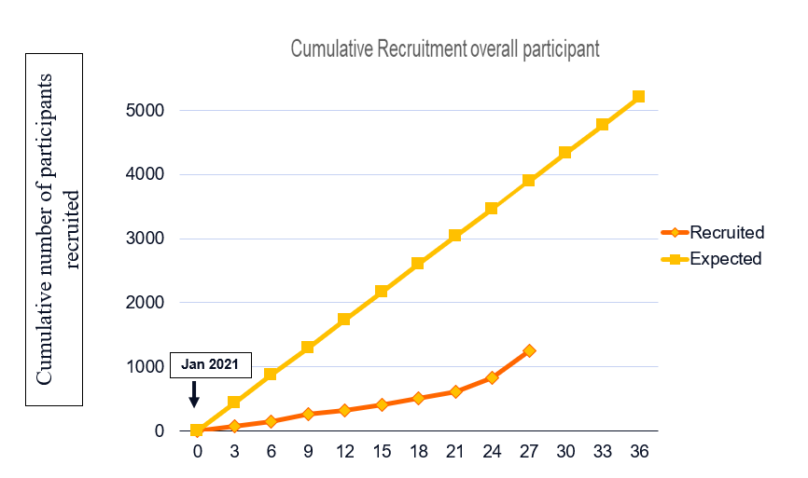
Cumulative Recruitment

Slide 14
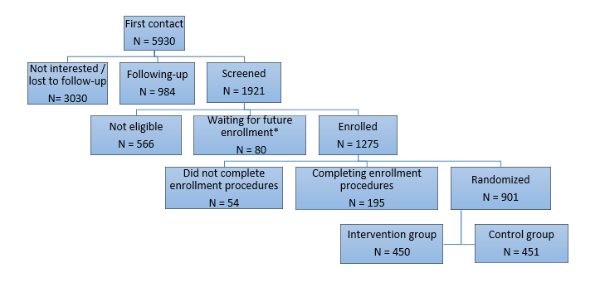
Recruitment: First contact to Randomization

Slide 15
Total HeLTI Canada Participants
335 Partners
410 Sibling Children
1646 participants with baseline data

Slide 16
Four Types of Families
Woman Only
34%
Woman & Partner
20%
Woman, Partner, & Sibling Child
18%
Woman & Sibling Child
28%

Slide 17
Recruitment by Settings
Settings | Woman (n=853)
Toronto | 202 | 24%
York Region | 36 | 4%
Peel Region | 34 | 4%
Niagara Region | 13 | 1%
Durham Region | 28 | 3%
Halton Region | 15 | 2%
Hamilton Region | 39 | 5%
Edmonton Region | 121 | 15%
Calgary | 29 | 3%
Other provinces | 86 | 10%
Ottawa (postpartum/newborn clinic) | 157 | 18%
TARGet Kids! (Toronto pediatric clinics) | 89 | 10%
Ontario = 72%; Alberta = 18%; Other = 10%

Slide 18
Current Demographics
77% married
1 % female same sex couple
82% 25 to 35 years old
13% < university degree
46% working full-time
29% < $100,000 household income
35% visible minority
36% not born in Canada
32% in Canada <6 years (recent newcomer)
47% overweight or obese
15% depressive symptoms

Slide 19
Recruitment Lessons Learned
Need to understand what message sells
Preconception care is a hard sell – unknown and undervalued
General vs specific messaging
“Are you planning a pregnancy in the next 3 years?” vs
“Free tailored support for you and your baby”
Successful social media recruitment is a skillset – hire an expert
Spam, monitoring google analytics, geo-targeting
Hospital-based recruitment is costly and has not yet been effective
No busy waiting rooms, limited time between patients, covid control
Breastfeeding clinics are not yet up to capacity
In general, lower rates of research participation in Canada

Slide 20
Additional HeLTI Canada Activities
Study Component | Activities | Completed | Ongoing
Intervention Standardization | Pilot test | Intervention manual | Monthly meetings with nurses
 | HeLTI Goals Guideline 9 goals with 26 outcomes 86-page intervention resource | Each outcome has: Links to authority documents Links to support programs Links to videos, webinars, and podcasts Specific nurse management strategies Red flags listed that warrant further assessment
 | Fidelity | Protocol and weekly reports | 1 manuscript published
 | Intervention development | Outline of intervention development process and components | 1 manuscript in progress
 | Evaluation of HeLTI nurse training | 2-part evaluation of the Healthy Conversation Skills trainings | Data analysis
Validation Studies | Reliability and validity of child anthropometry in 2 research staff verses 1 research staff and a parent ➔ to be compliant with WHO measurement protocol Understanding parent perspectives of participation in anthropometry in clinical research Reliability and validity of anthropometry measured in the home setting by parents versus in-person using standardized instructions |  | 1 manuscript published 2 manuscripts submitted
Move to Lunenfeld Tannenbaum Research Institute | Sinai Health | Over 70 staff laid off and rehired New REB, contracts New email addresses and IT requirements Transfer CIHR grant other financial changes |  | Consolidated HeLTI office space with shared resources among HeLTI Canada, India and South Africa

Slide 21
Intervention Dosage – Active Phase
Indicator | Mean | N
Delivery Mode: Telephone or Video call
Mean number of contacts | 5 contacts per family | 3601 contacts
Mean duration of an intervention session | 27 minutes | 1620 hours
Delivery Mode: Email or Text
Sessions delivered | 3 contacts per family | 2201 contacts
General Information
Completed session details in the activity log | 14 logs per family (Range 1 to 51 logs) | 5554 logs

Slide 22
Grants, Publications, Capacity Building
Subject | Principal Investigator | Funding Source
Prevention of gestational diabetes in preconception period | R. Retnakaran | CIHR
Validating a measure of early infant self-regulation | M. Wade | Spencer Foundation
HeLTi microBIOme MarkErs of pregnancy Mood | A. Kozyrskyj | CIHR
Understanding weight bias in women and their children | T. Nagpal | New Investigator
An evaluation of a ehealth coparenting intervention among women and their partners in the prevention of postpartum depression and anxiety | C. Dennis | CIHR
An implementation science study of a collaborative care intervention to prevent antenatal depression Toronto and Soweto | C.Dennis C Birken S. Norris | Global Alliance for Chronic Disease
Understanding the paternal contribution to the developmental origins of offspring cardiovascular disease | K Miliku
2022 Publications
10 published manuscripts
Capacity Building
5 postgraduate students; 2 postdoctoral fellows; 7 new investigators

Slide 23
Sex- and Gender-Based Analysis
Developed a framework for HeLTI Consortium
The objective is to integrate SGBA into four trial domains
Domain #1 Study design and methods
Domain #2 Analyses
Domain #4 Partnerships and Patient/Public Involvement
Domain #3 Knowledge Translation

Slide 24
Following DOHaD workshop in Vancouver 2022 → consulted with KT experts
Hired a team member who previously worked at CIHR in the area of KT
She has assisted us in developing a draft KT plan

Slide 25
Relevance
Major Interest in HeLTI Canada
Addresses an identified health care gap
Medical Officers of Health = policy stakeholders
Public health units = practice stakeholders
Valuable intervention to implement to meet practice standards
Scalable due to the technology base
Public health nurses keen to participate = target providers – Hired and trained over 75 public health nurses
Recruitment of nurses has been exceptional – role fits into their skillset and is enjoyable to deliver
Capacity building – currently practicing public health nurses

Slide 26
Summary
Fantastic platform across Canada
Family focus - 2100 fathers with data parallel to mothers
3200 sibling children to compare outcomes and intervention timing
Methodologically strong trial with a focus on ensuring intervention fidelity
Significant learning in engagement of a preconception population: web-based vs clinical-based
Public health practitioners entirely engaged and see this intervention as their role
High retention rates and high intervention engagement
Ensuring scalability - provincially and nationally
Economic evaluations planned for each phase

Slide 27
Thank you

