Slide 1



BUKHALI (SMART):
BUilding Knowledge and a foundation for HeAlthy Life trajectorIes
HeLTI South Africa-Canada
Meeting in Shanghai
November 2018

Slide 2


Slide 4
Completed baseline data collection & randomisation of 6,000+ women
Attrition: 5% attrition per annum (< than anticipated 10%)
Complete data collection: 94% of participants
Intervention & control fidelity: 92%
Biological samples collected: 163,680
Complete sample collection: 93% of participants
Samples are inventoried on a LIMS database (cleaned)
Integrated REDCAP data management system
Data points: 3,2+ million
Variables: 4000+
Data-shield ready

Slide 5
23 Early Career Researchers
  10 PhDs (4 graduated)
  13 postdocs (10 active)
17 nested projects
  6 SAMRC funded collaborative projects
63 papers in print, in press or in preparation
Core protocols all published
  RCT
  Fidelity
  Intervention development

Slide 6
Process evaluation:
815 qualitative data points
  455 evaluations of intervention & control teams
  165 compliance observations
  17 staff debrief sessions
  36 participant focus groups
  142 participant in-depth interviews

Slide 7
Process evaluation:
Participant engagement mixed methods

Slide 8

Process evaluation projects completed:
Implementation of Healthy Conversation Skills
Barriers & facilitators of multi-micronutrient supplement use
SMS’s to promote supplement use
Mobile technology use challenges
Implementation of FIGO checklist for nutrition support
Socio-ecological factors influencing pregnancy termination decisions
Understanding social support dynamics

Slide 9

Process evaluation projects ongoing:
Participant qualitative longitudinal study
Fathers:
  Perceptions of relationship dynamics, pregnancy and fatherhood
  Engagement in research
Community Health Workers:
  Intervention implementation
  Risk identification, referral and management
  Experiences as community health workers

Slide 10

Sex & Gender Champion Project:
To quantify the burden of violence experienced by young women
To determine the impact of violence exposure on maternal and child outcomes
To assess if women in the intervention arm who receive health and psychosocial support move into more stable relationships or living arrangements following pregnancy & childbirth
Lisa Ware & Jennifer Jenkins

Slide 11




Bukhali Platform
Intervention efficacy
Epidemiology
Biology
Implementation
Practice & policy impact

Slide 14
Community leaders
Stakeholder Advisory Group
SA Government (multi-sectors)
WHO
UNICEF
Academics
NGOs
Community representatives
Young women & Public
Scientific community
Engagement has focused on: community access, staff safety, preconception health, obesity & early child development

Slide 15
Community leaders
Responsive to community leaders
Disseminating study information and updates at community forums

Slide 16
Poor understanding of preconception health within a context of high unplanned pregnancy rates
Developed & implemented “Living your best life” radio series (11 episodes) with website support
Public
Partnered with R-Labs developed 3 micro-courses:
Gender based violence
Depression
Suicide
Partnered with ZLTO (block chain technology) to disseminate to youth
4500+ youth engaged with the micro-courses

Slide 17
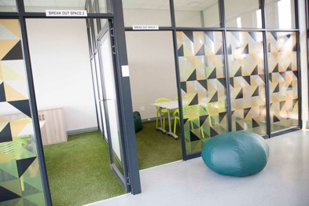
Partnership to address youth unemployment
Training youth as Community Health Workers
Integrated Healthy Conversation Skills training
HeLTI SA employing these youth into the intervention team
Implementation learning

Slide 18
Adolescent girls:
Triple burden of malnutrition
  Decreasing % underweight (∼8%)
  Increasing % overweight & obesity
  Mild aneamia: ∼30%

Slide 19
HeLTI Adolescent RCT (14-19yrs)

Slide 21
Multimorbidity (e.g. hypertension, diabetes)
Young woman
Trauma (risk of depression and anxiety)
Malnutrition (anaemia)

Slide 22
Multimorbidity (e.g. hypertension, diabetes)
Behaviour change
Health literacy
Young woman
Trauma (risk of depression and anxiety)
Behaviour change intention
Improved physical and mental health
Malnutrition (anaemia)
RCT Intervention

Slide 23
Dynamic Process
Multimorbidity (e.g. hypertension, diabetes)
Behaviour change
Health literacy
Young woman
Trauma (risk of depression and anxiety)
Behaviour change intention
Improved physical and mental health
Malnutrition (anaemia)
Time
RCT Intervention

Slide 24
Dynamic Process
Limited employment and education opportunities
Economic stress, increased cost of living
Food insecurity
Poor social support
Community crime and exposure to violence
Variable instability
Multimorbidity (e.g. hypertension, diabetes)
Behaviour change
Health literacy
Young woman
Trauma (risk of depression and anxiety)
Behaviour change intention
Improved physical and mental health
Malnutrition (anaemia)
Time
RCT Intervention

Slide 25
Dynamic Process
Limited employment and education opportunities
Economic stress, increased cost of living
Food insecurity
Poor social support
Community crime and exposure to violence
Variable instability
Multimorbidity (e.g. hypertension, diabetes)
Increased instability
Behaviour change
Health literacy
Young woman
Trauma (risk of depression and anxiety)
Behaviour change intention
Improved physical and mental health
Malnutrition (anaemia)
Time
RCT Intervention

Slide 26
Dynamic Process
Limited employment and education opportunities
Economic stress, increased cost of living
Food insecurity
Poor social support
Community crime and exposure to violence
Variable instability
Multimorbidity (e.g. hypertension, diabetes)
Increased instability
Behaviour change
Health literacy
Young woman
Trauma (risk of depression and anxiety)
Behaviour change intention
Improved physical and mental health
Malnutrition (anaemia)
Increased stability
Time
RCT Intervention
Community Health Worker

Slide 27

Community Health Workers
Important health care workforce
Training opportunities for youth
Data science support (health systems strengthening)
Mechanisms of impact (stability)
Challenges as “change agents”

Slide 28
Obesity vs. Fat
Disconnect between clinical and community perceptions around obesity
Terminology & relevance
General inability to self-assess obesity-risk
“Obesity is fat in a normal way”

Slide 29
Multi-morbidity & multi-risk behaviour
Substantial health burden in young women
  Metabolic
  Malnutrition
  Mental Health
Coupled with multiple risk behaviours
Partnership with “International Core Indicators for Preconception Health and Equity (iCIPHE) Alliance”
  To promote introduction of preconception health indicators

Slide 30
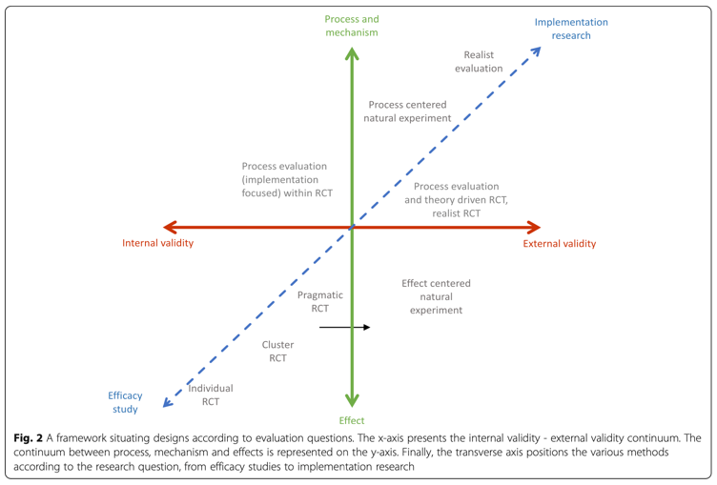
Methodological contribution
Complex intervention designs
(balancing external & internal validity)

Slide 31
...to the 70+ team behind the data

