Slide 1
Sino-Canadian Healthy Life Trajectories Initiative – SCHeLTI
Principal Investigators: Phase 1: William D. Fraser
Hefeng Huang
Phase 2: Jean-Patrice Baillargeon
Jianxia Fan
HeLTI Council
April 2023
Notes:
Dear ladies and gentlemen,
I am the project PI of the Sino-Canada team, Huang Hefeng, and I am happy to share with you the current progress of the project

Slide 2
Key highlights of study progress
As of December 31st 2022, 92% (4,155/4,500) of projected sample enrolled
Launching of the Song Jiang site: 6 new clusters, each with 50 participants, to achieve power of at least 80%
Planned end of recruitment July 2023
Follow-up in postnatal stage ongoing : 3,128 babies born
Compliance to study intervention is high (88% to 96% with adherence > 80%)
Retention in cohort is our priority focus in the second cycle of the study; so far
2% formal withdrawal,
compliance to postnatal follow-up visits 79 to 92%
As of December 31st 2022, 83,954 biosamples have been collected

Slide 3
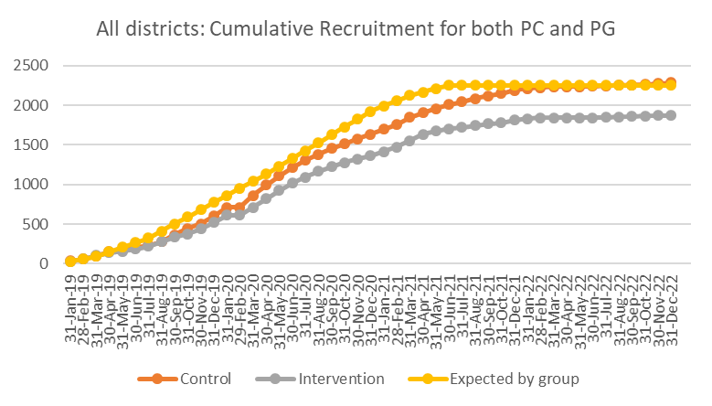
Cumulative Recruitment by study group
(From Jan 10th, 2019 to Dec 31th, 2022)
Cumulative number of participants recruited
Months

Slide 4
Milestones achieved and ongoing work
Study Component | Activities | Finalized | Ongoing
Postnatal Case Report Form (CRFs) | Development and programming | Until 48 months | CRF 60 months
Postnatal intervention program | Design, implementation and intervention App development | Until 5 years old | Refining of the monitoring module

Slide 5
Gantt chart: SCHeLTI
Dec 2022
Xuhui
Aug 18 – Jan. 19
Jan 2019
Changning
Jan 19-Apr. 19
Apr 2019
Minhang
Jun- Aug 19
Aug 2019
Fengxian
Apr 2020
May 2020
Song Jiang
Mar 2023
Apr 2023
Pilot study
Formal study
First patient
in trial
Jan 2019
First Baby born
Jun 2019
Last patient
in trial
Jul 2023
Last Baby born
Jan 2024
Last child achieving 5 y.o. Jan 2029
Notes:
With you As a team, We have been working hard since 2018 to conduct the LIFE TREE project."

Slide 6
Impact of the COVID-19 Epidemic
Wave 1
Jan 24th to Apr 15th 2020
Wave 2
Mar 11th to Jun 6th 2022
Wave 3
Dec 03th 2022 to Jan 20th 2023
Staff
Recruitment
Cohort Follow-up
Intervention
Biobank
MCHs staff assigned to the COVID clinics
IPH data clerks and intervention nurses conducted the postnatal cohort and intervention visits
The recruitment of participants was interrupted for almost 6 months
Visits that had been planned as in-person study visits were conducted by telephone
The face-to-face Healthy Conversation and Nutrition counseling sessions were conducted over the phone
Group courses were suspended => Courses were video recorded and sent to intervention group through the App
Collection of bio-samples was suspended during the COVID-19 lock down.
Specimens collected at routine clinical visits were maintained.
Significant decrease of the intervention and cohort visits compliance
Missing child’s anthropometric measures
Resistance of participants to come back to face-to-face visits, either for intervention or cohorts visits
Notes:
1-Thus, our study was required to adapt to infection control regulations, including directives to participants that all nonessential contacts should be interrupted. All planned face-to-face follow up visits were then conducted by telephone. We accommodate participants according to their availability to maintain the compliance to study visits. The research staffs were asked to extend the work time until 9 pm and during weekends. After the down grading of the public health response, the flow for the visits has progressively returned to near normal.
2-The MCHU staffs who were responsible to referring preconception participants to the Changning recruitment site were required to take on responsibilities at the Shanghai Airport until May 2020.
The recruitment of the PC participants was reduced and the return to the normal flow was delayed at this site.
During the shutdown, a skeleton field staff was maintained on at all recruitment sites to address queries and to follow-up participants who came to hospital for routine care.
3-Visits that had been planned as in-person study visits were conducted by telephone during the shutdown period. Thus, anthropometric measures could not be obtained during this period of pandemic. Some participants were resistant to reinitiate face-to face visits. This reluctance has progressively decreased, and face-to-face visits are now returning to baseline levels.
Biobank
Collection of most of the bio-samples was suspended for a four-month period due to COVID-19. Specimens collected at routine clinical visits were maintained.
Because women admitted to the hospital for delivery were tested for the COVID-19, the Infection Control Bureau allowed the collection of the SCHeLTI biosamples at the time of delivery.
Action: We developed an App message to inform the participants that the study flow has returned to normal and invite them to send us the biosamples that they were instructed to collect at home (stool, breast milk).

Slide 7
Adherence to Protocol for
Data Collection Visits
Data cut-off: December 31st, 2022
Time point for Data collection visits | Visits completed over expected (%) | Visits completed within time window (%)
Preconception V1 to V4 | 79 to 100% | 91 to 100%
Pregnancy V1 to V3 | 95 to 99% | 99 to 100%
Delivery | 92% | 94%
Postnatal visit 6 weeks to 24 months | 83 to 88% | 88 to 96%

Slide 8
Adherence to Protocol for
Healthy Conversation Sessions
Data cut-off: December 31st, 2022
Number of HC sessions | Low Intensity Intervention |  |  | High Intensity Intervention
 | Maximum expected for the study phase | nª | Percentage of participant with a compliance > 80% | Maximum expected for the study phase | nª | Percentage of participant with a compliance > 80%
Preconception phase | 13 | 332 | 90% | 26 | 332 | 81%
Pregnancy phase | 7 | 566 | 93% | 15 | 1341 | 95%
Infancy phase | 24 | 623 | 73% | 41 | 986 | 80%
Childhood phase | 11 | 81 | 93% | 17 | 15 | 100%
ª Participants having spent sufficient time in a study phase, for whom at least one Healthy Conversation session is expected to have been delivered

Slide 9
GRANT SUBMISSIONS, PUBLICATIONS
and MENTORSHIP
TOPIC | Funding Organization | Principal investigator(s) | Duration | Value | Status
Heavy water and adiposity measure validation | International Atomic Energy Agency (IAEA) | Ouyang | 2017/8 - 2023/8 | $50,000 | Funded
PUBLICATIONS:
18 publications (18 published; 1 under review; 2 in preparation)
MENTORSHIP:
25 masters/PhD students and 4 postdoctoral fellows involved in SCHeLTI project

Slide 10
Lessons learned
during the last 6 years
Importance of Flexibility and Adaptability:
The COVID-19 pandemic created many unforeseen challenges that thought us to have contingency plans in place to handle unexpected events
Communication:
Effective and timely communication with study sites, stakeholders, and participants
Ongoing collaboration and sharing of best practices across the HeLTI Consortium
Continual Learning:
Ongoing process of learning and improvement; regularly assessing trial implementation & fidelity outcomes, identifying areas for improvement, and implementing changes.

Slide 11
Identifying research priorities and publications
Take advantage of our ongoing trial to share experience and answer research questions on context, processes, fidelity or proximal results:
Publications:
Intervention development paper
Intervention fidelity paper
COVID impact, etc.
Research sub-studies:
Feasibility and acceptability of the Healthy Conversation Skills model to support healthy lifestyles in Shanghai – Qualitative study with families and HCP in Shanghai; with possible support form WHO
Sex and Gender specificities in Shanghai regarding perceptions, attitudes, parenting, etc. – Qualitative study with families in Shanghai

Slide 12
Identifying research priorities and publications
Meeting of SCHeLTI Canadian co-investigators on February 6, 2023.
Spreadsheet documenting researchers who have taken a role for each domain of variables being collected, and those willing to take leadership roles for a domain.
Investigators have been encouraged to propose research priorities for the short term, within the next year
Research ideas: will be discussed tomorrow…
Challenge of including high-level decisionmakers in the process of identifying research priorities and informing the analysis plan
Notes:
Meeting included Sex and gender champion, statisticians and health economist

Slide 13
Challenge of Data Access for Canadian investigators
New regulatory body, under the auspices of the Minister of Science and Technology (MOST), has been established in China to oversee data sharing in international studies
GOAL: Canadian SCHELTI team members will achieve full scientific partnership with Chinese colleagues, through:
Significant contribution to the development of the study,
Data sharing: researchers, whether Chinese or Canadian, have equal access to SCHELTI data
Balanced recognition of the intellectual contributions to the programme, including respect of internationally recognized authorship principles.
Steps to achieve goal:
Submission to Chinese regulatory approval for data sharing (Ongoing)
Mechanisms approved by the Executive committee are implemented to ensure the application of the guidelines (Governance, Application for access to DB & BB).
Notes:
This includes standard measures of scientific contributions and achievement : first and senior authorships according to interational standards, leadership roles in ancillary studies, graduate student supervision, and mentorship of young investigators, both Canadian and Chinese, who join the SCHELTI initiative.

Slide 14
Other challenges
Completing recruitment:
Engagement of district and MCH leaders at Songjiang
Retention in trial:
To ensure participant retention, the trial requires ongoing adaptation of retention strategies in response to changing circumstances and evolving participant needs
Maintain engagement of key decision and policy makers
Important for the feasibility of the trial (e.g. data access), funding of research ideas and scale up of the SCHeLTI intervention in Shanghai and China
We have good collaboration with Dr. Guowei Zhu, responsible for planning childhood health promotion policies in Shanghai’s Xuhui District, knowledge users (Drs Jiang, Ouyang, Shu), UNICEF-China, etc.
We need to get more attention from high-level health care decision makers in Shanghai and China
Notes:
Support and guidance of the Councuil

Slide 15
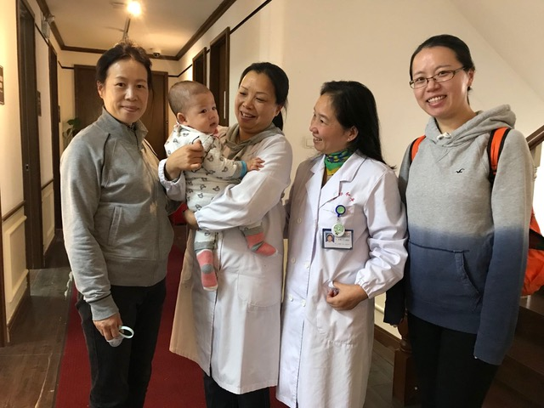
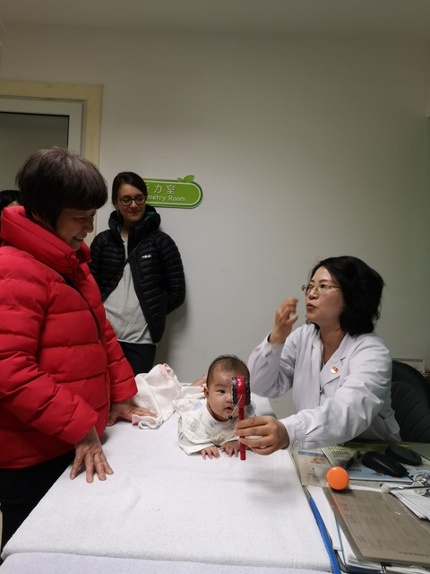
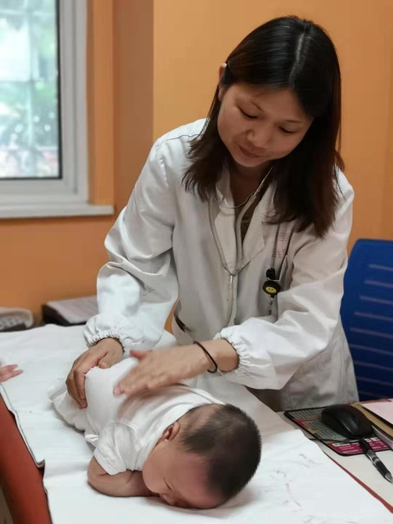
Thank you…
We hope to see you in Shanghai for a next in-person council meeting !

