Slide 1
Sex-and-Gender Based Analysis
Cindy-Lee Dennis, PhD, FCAHS
Professor in Nursing and Psychiatry, University of Toronto
Research Chair in Women’s Health, Unity Health Toronto/St. Michael’s Hospital
Catherine Birken MD, MSc, FRCPC
Professor, Department of Paediatrics, University of Toronto
Scientist, Child Health Evaluative Sciences, SickKids Research Institute

Slide 2
CIHR Sex-and-Gender Based Analysis Mandate
"The Canadian Institutes of Research (CIHR) SGBA Research Action Plan aims to systematically integrate an SGBA into CIHR-funded research to ensure that funded research is relevant and impactful for Canada's diverse population".
The goal is to ensure the research CIHR funds are relevant and impactful for Canada's diverse population by building SGBA capacity and strengthening SGBA expertise within the research community and CIHR.
From: “How CIHR is supporting the integration of SGBA” from CIHR website 2018 [Available from: https://cihr-irsc.gc.ca/e/50837.html.]

Slide 3
What is Sex-and-Gender Based Analysis?
Sex-and-Gender based analysis (SGBA) is an analytical process used in health research to determine whether interventions have differential effects for men and women or girls and boys.
Sex refers to biological attributes in humans and animals primarily associated with physical and physiological features, including chromosomes, gene expression, hormone levels and function, and reproductive/sexual anatomy.
Gender refers to the socially constructed roles, behaviours, expressions and identities of girls, women, boys, men, and gender-diverse people.
From: CIHR. What is Gender? What is Sex? Ottawa: Institute of Gender and Health 2020 [Available from: https://cihr-irsc.gc.ca/e/48642.html.

Slide 4
HeLTI SGBA Strategy
The HeLTI SGBA strategy aims to generate, understand and apply evidence related to sex/or gender-related factors and interactions through a life course approach that will inform international policy and decision-making for improving health and preventing non-communicable diseases (NCDs).

Slide 5
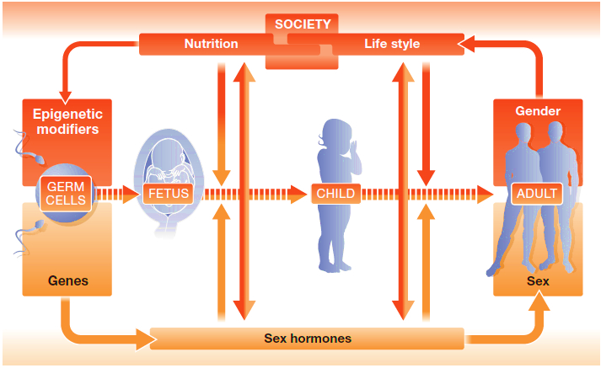
How Sex and Gender Interact throughout the Life Course
Taken from: Gendered Innovations in Science, Health & Medicine, Engineering, and Environment, downloaded April 11, 2023, from http://genderedinnovations.stanford.edu/methods/how.html)
Notes:
What we know about the diagnosis, treatment, and prevention comes from research on male cells, male mice, and men; differences between men and women in epidemiology, pathophysiology, clinical manifestations, psychological effects, disease progression and response to treatment characterize diseases (5). Sex is an essential modifier of biology and disease via genetic, epigenetic, and hormonal regulations. Gender is a determinant of patient and provider's behaviour, and sex and gender impact depression and suicide and the development of major chronic diseases such as heart disease, cancer, chronic pulmonary disease, stroke, and diabetes.
It is important to analyze the complex interdependency of sex and gender throughout the human life cycle (Regitz-Zagrosek, 2012). If we take health status, for example, sex influences health by modifying behavior. At the same time, gender behaviors can modify biological factors. Although women and men are fundamentally alike, differences of sex and gender can interact to produce differing health outcomes.
From HeLTI Protocol -- Mechanisms of Programming. The early-life environment can influence ‘phenotypic plasticity’ and long-term ‘metabolic memory’ through epigenetic mechanisms, namely, DNA methylation, histone structure, and micro RNAs. Environmental factors -- maternal/paternal diet and body composition,^{59–61} parental stress, and nurturing behaviour postnatally,^{62–67} can each induce epigenetic modifications in target tissues of the placenta and fetal/infant pancreas and liver, altering gene expression and disease tendency later in life, including the metabolic syndrome. For example, at birth, methylation of the retinoid X receptor in cord blood leucocytes is associated with adiposity in childhood.⁶⁸ Animal studies have shown that paternal and maternal diet and stress/anxiety can influence the offspring’s epigenome.⁶⁹ Epigenetic changes caused by maternal diet and stress may be heritable across generations,^{60,70} emphasizing consideration of optimizing inter-generational nutrition. Data also suggest that maternal preconception body composition, obesity, and diabetes, shape the gut microbiome of the fetus^{71–77} which are subsequently required for nutrient production and metabolism.⁷⁸ Gut bacteria are also critical for immune system regulation and maintenance of immune barriers. The maternal microbiome may influence not only fetal/infant growth, but the infant’s own microbiome, such as transfer of microbes and nutrients in breast milk.⁷⁹ Parental anxiety and depression directly influences the quality of parental care. High quality parental care during early life is integral to a child’s cognitive function and health outcomes in later life. Those who receive low quality parental care are more sensitive to stress and display more behavioural problems. Early environments also affect brain structure. Early deprivation (neglect, maltreatment) can lead to changes in the shape and volume of various brain structures, especially in regions involved in learning and memory.⁸⁰ Hence, adverse nutritional and mental health exposures can further exacerbate the likelihood of NCDs.

Slide 6
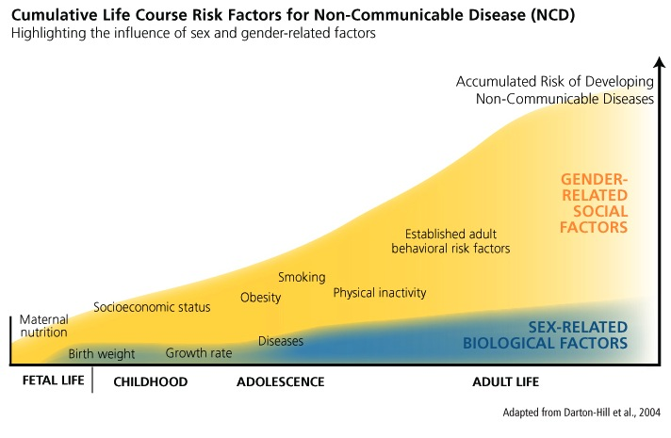
How Sex, Gender, an other Factors Interact in Nutrigenomics
Notes:
Both sex- and gender-related factors determine an individual's functional capacity across the course of their life. Because sex and gender interact, it is difficult to identify the respective influences of each factor independently.
Intervention Overview. Our intervention will take a ‘cumulative-impact’ approach designed to improve health behaviours and reduce modifiable risk factors that influence child obesity. The intervention will start prior to conception and continue through to early childhood. It will be evidence-based, professionally-facilitated, proactive, individualized, multifaceted, and sex and gender specific. It will build on existing research and clinical resources while recognizing the growing trend of e-Health.¹⁸⁹ Local stakeholders, such as public health nurses, will participate in providing the intervention to ensure it is tailored to local circumstances. Our intervention will target not only women but also their partners and other key individuals in the child’s environment who can influence child health. Among primiparous women, we will also provide information to address concerns with the sibling child with the goal of taking a family-approach to care. Our intervention, with its foundation on public health and primary care platforms and e-Health technologies, is structured to facilitate scalability across Canada, if effective.

Slide 7
Sex as a Biological Variable
CIHR recommends accounting for sex as a biological variable in basic science, clinical, health system and population health studies where appropriate.
A strong SGBA plan:
Clearly articulates that a phenomenon, condition or disease under study has, or does not have, a different incidence or prevalence based on sex
Includes or recruits male and female cells, tissues, animals or humans when studying models of disease that affect males and females
Documents and analyzes the sex of the cells, tissues, animals or humans used in the protocol
Disaggregates results by sex
Builds on what is already known about sex differences as well as sex-related mechanisms in the field of study

Slide 8
Gender as a Social Determinant of Health
CIHR recommends accounting for gender as a sociocultural determinant of health in the clinical, health system and population health studies where appropriate.
A strong SGBA plan:
Reports what is known about gender, gender theories, and/or intersectionality in the field of study where relevant in the literature review
Describes how gender will be measured or investigated in the population under study
Addresses and mitigates bias in recruitment strategies
Describes how gendered sub-groups will be compared and that the findings will be reported separately in the results section
Considers aspects affected by gender in the implementation and knowledge translation plan.

Slide 9
SBGA Objective – Program Domains
The HeLTI SGBA objective is to integrate an SGBA into its program domains, namely, research study design and methods, data collection and analyses, knowledge translation and implementation, partnerships and patient/public involvement.

Slide 10
Domain #1 – Research Design and Methods
Literature review and research objectives.
Knowledge and gaps or questions about sex and gender are identified.
Clear articulation that the condition or disease under study has, or does not have, a different incidence or prevalence based on sex.
Research objectives include exploration of sex and gender.
Sex and gender considered in the design, e.g. In addition to maternal factors in child health, the role of fathers/partners, including the genetic/epigenetic and environmental factors.
Participant recruitment and retention.
Inclusion/exclusion and recruitment methods address potential barriers and mitigate gender bias (implementation evaluation)
Sex and gender considered in the recruitment and retention strategies i.e., examining the barriers and enablers (implementation evaluation)
Sample size calculation – is the sample sufficiently powered to identify potentially relevant sex/gender findings

Slide 11
Domain #2 – Data Collection and Analysis
Data collection
Intake forms capture sex and gender identities.
DCIs include variables to conduct sex/gender analysis.
Analysis
Data is disaggregated by sex.
Statistical analysis assesses the effect or association of sex and/or gender.
Primary outcome is stratified by sex and/or gender.
Describing how gendered sub-groups will be compared and that the findings are reported separately in the results section.

Slide 12
Domain #3 – Knowledge Translation and Implementation
Implementation and knowledge translation plans consider input by sex and gender, e.g., incl in KT advisory committee composition.
KT messengers – delivered by women only, men only, men and women separately or together.
KT messaging and strategies –dissemination messages are tailored to respond to sex and gender-related factors.
Target policies and system change, e.g., addressing "gender gaps" in policies and systems.
Implementation evaluation – consider sex and gender in decision-making, engagement, barriers, enablers and preferences for the uptake of the intervention.
Publications reporting using Sex and Gender Equity in Research (SAGER) guidelines.
Notes:
SAGER guidelines developed in 2016 by international panel of experts. SAGER guidelines are a comprehensive procedure for reporting of sex and gender information in study design, data analyses, results and the interpretation of findings.

Slide 13
Domain #4 – Partnerships and Patient/Public Involvement
Capacity Building – Providers, collaborators and research team training– SGBA Training (free online competency modules from CIHR’s, Institute of Gender and Health (IGH), https://cihr-irsc.gc.ca/e/49347.html ).
Patient/public involvement where sex and gender are considered in governance and committee composition.
Partnerships including sex and gender expertise such as Women’s College Hospital, Women’s Xchange to support the integration of sex and gender in health research.

Slide 14
Evaluating Sex and Gender Integration
Evaluation of sex and gender integration will be conducted in collaboration with the Women’s Xchange Sex and Gender Research Support Services.
Quantitative and qualitative indicators will be developed for relevant aspects of the study findings, and the KT and the intervention implementation evaluation.
Sex and gender indicators and evaluation metrics will be selected based on the previous work done by sex and gender experts (Day S., et al. 2016 & 2017)
Notes:
Day, S., et al. (2016). "Integrating and evaluating sex and gender in health research." Health Res Policy Syst 14(1): 75. Day, S., et al. (2017). "Essential metrics for assessing sex & gender integration in health research proposals. involving human participants." PLoS One 12(8): e0182812.)

Slide 15
Acknowledgements

Slide 16
Discussion and Q & A

