Slide 1

HEALTHY LIFE TRAJECTORIES INITIATIVE (HeLTI)
EARLY INTERVENTIONS TO SUPPORT TRAJECTORIES FOR HEALTHY LIFE IN INDIA (EINSTEIN)
HeLTI Council Meeting 18-19 April 2023

Slide 2
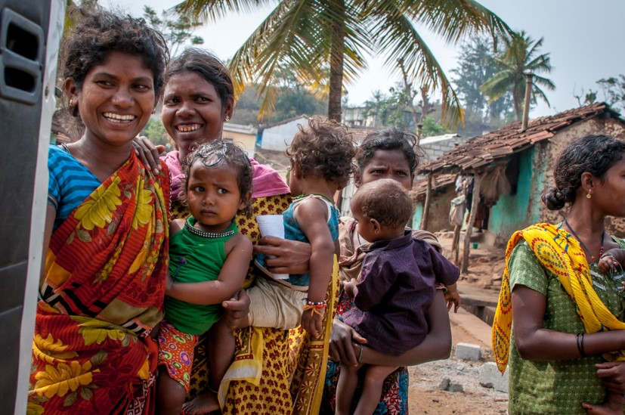
STUDY DESIGN
Community-based cluster study; villages as unit
105 villages randomly into 3 arms; ~ 6000 women; ~2100 children at 5 yrs
Pre-conception
Pregnancy
Post-natal
Arm 1
Arm 2
Arm 3
Multi-faceted interventions
Standard care
>95% power for primary outcome; ~80% to detect sex-specific differences
Primary outcome: Adiposity (Fat mass index) at five years

Slide 3
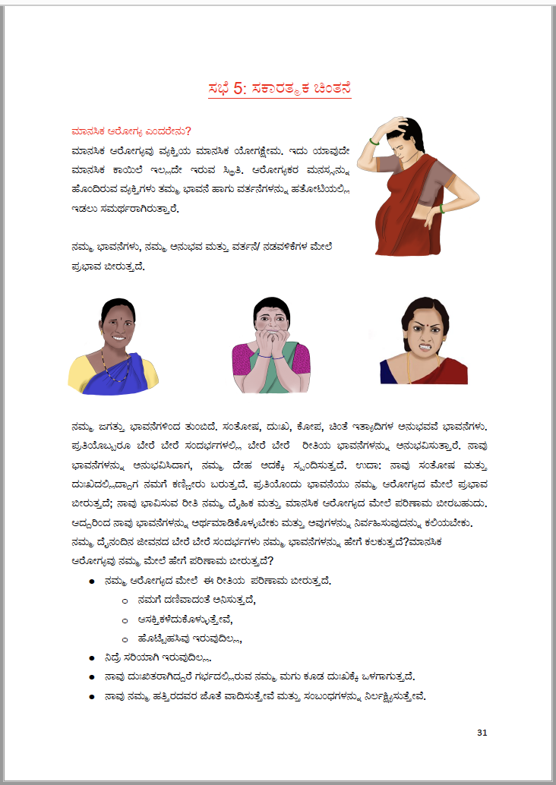
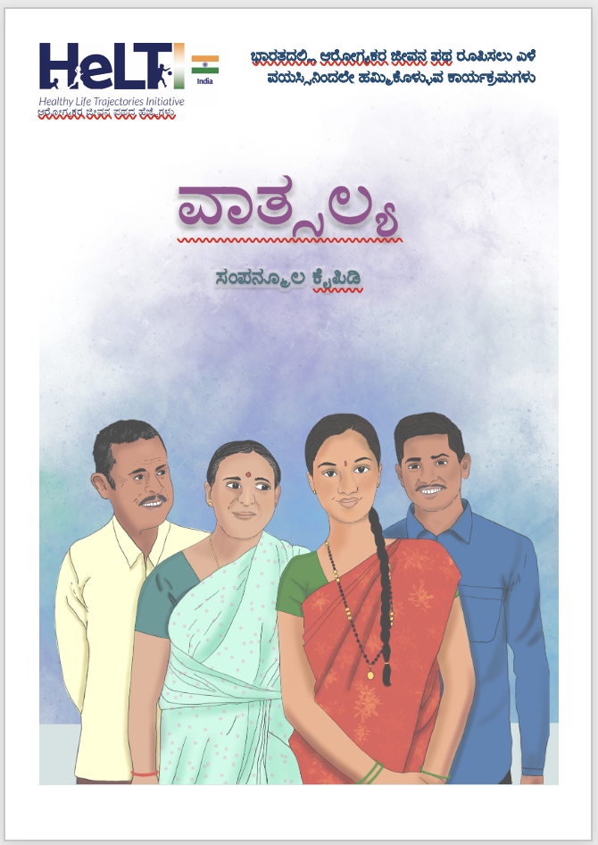
INTERVENTION PACKAGE
Pre-conception
Pregnancy/post-natal
Diet; physical activity; mental health;
toxin/pollution exposure; hygiene
Intervention modules – six sessions
  Cyclical, short amplitude
  Two modules for fathers
Underpinned by behaviour change
Pre-conception+
Group parenting programme with a cognitive behaviour therapy (LTP+)
Nutrition – maternal & child
Physical activity

Slide 4
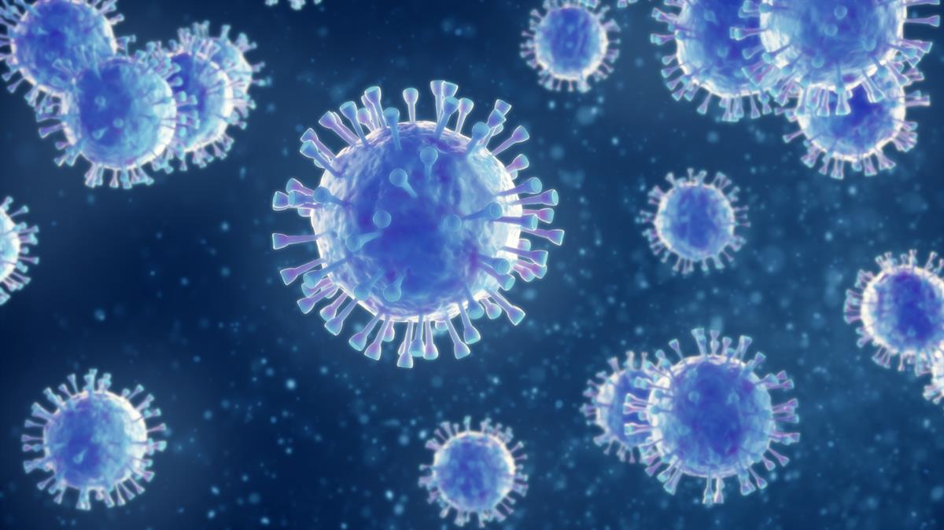
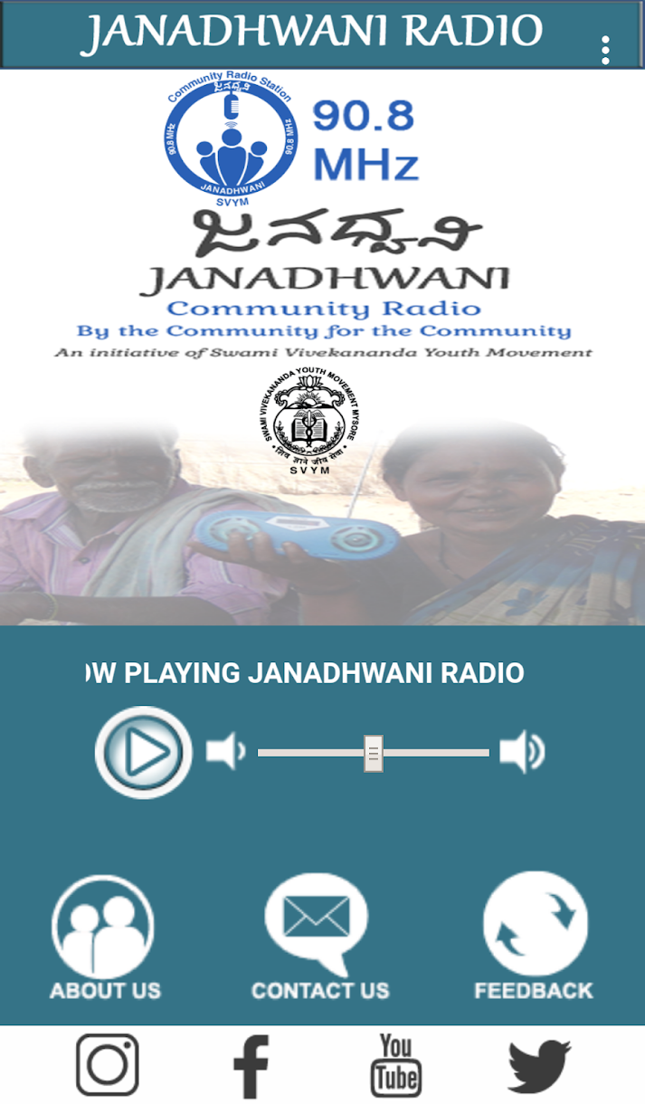
IMPACT OF COVID
Delayed enrolment/data collection/disruption
Ethical issues
Community perceptions
  Contact with outsiders
  Unwilling to undergo physical contact
  Unwilling to attend groups.
Mitigation:
Maintain rapport with community
  Awareness raising; support local Govt activities
  Community radio station
Engagement with participants
  Remote methods of data collection
  Individual intervention delivery

Slide 5
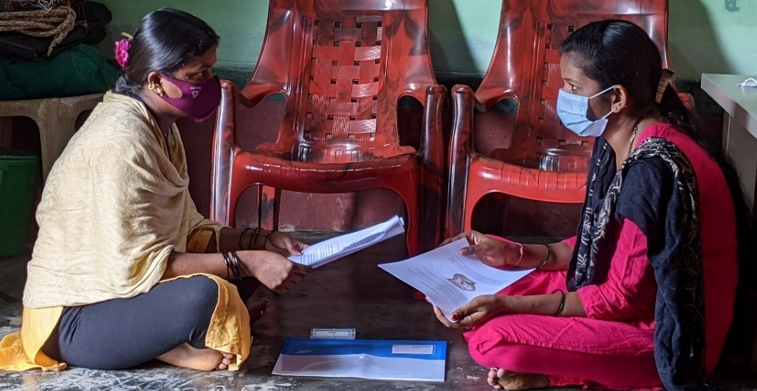
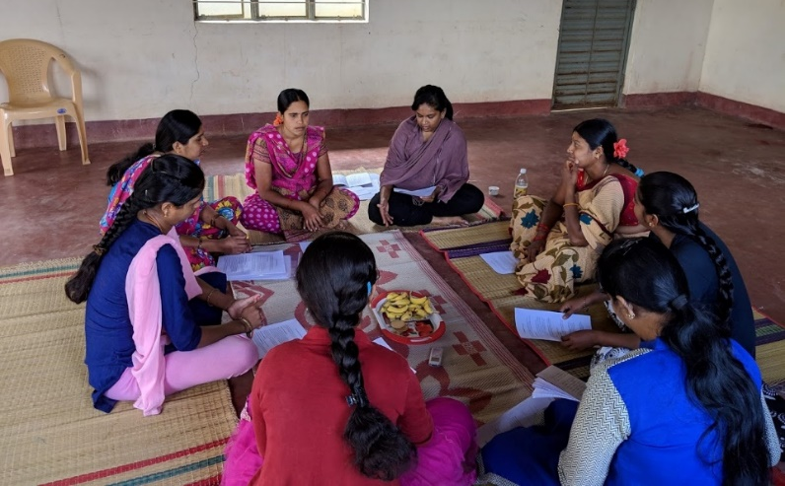
PROGRESS
Recruitment commenced Feb 2021; affected by COVID
Data collection commenced April 2021; remote methods using telephone / tablets
Face-to-face data collection commenced Nov 2021
Intervention delivery commenced Sep 2021; one to one delivery at participants’ residence
Biospecimen collection (mobile van) and anthropometry in field commenced Nov 2021

Slide 6
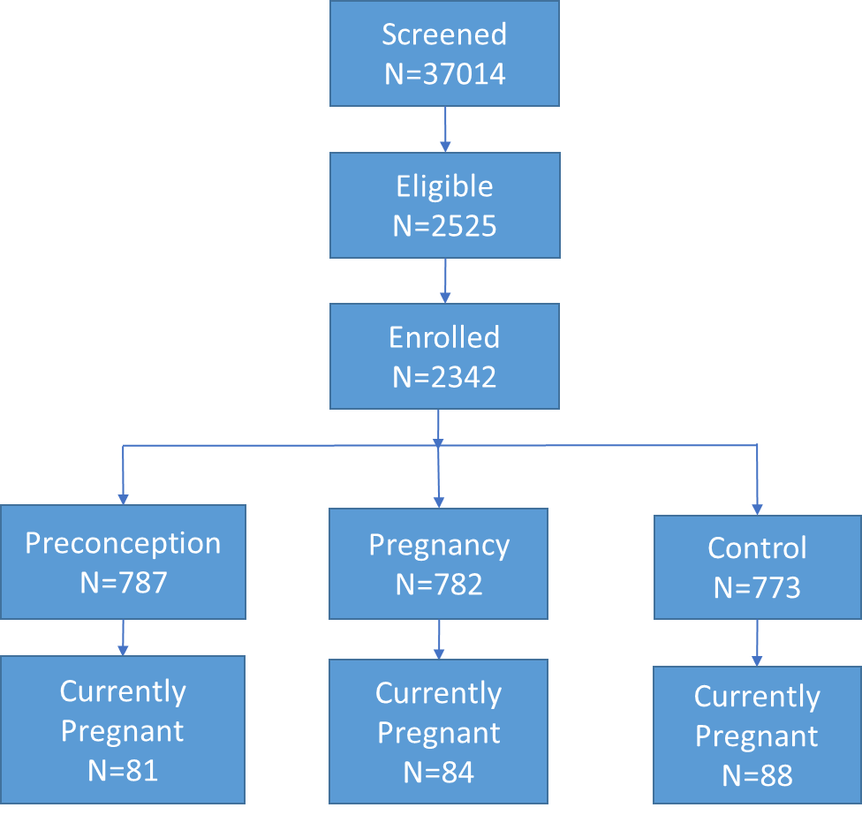
RECRUITMENT STATUS

Slide 7
RETENTION
 | Preconception arm | Pregnancy arm | Control arm | Total
Clusters | 37 | 36 | 36 | 109
Eligible women | 841 | 842 | 836 | 2519
Total enrolled | 787 | 782 | 773 | 2342
Permanently lost (death/pregnancy loss/permanent migration) | 53 | 66 | 27 | 146
Probably permanently lost (unwilling/not available/husband death/divorce) | 44 | 38 | 32 | 114

Slide 8
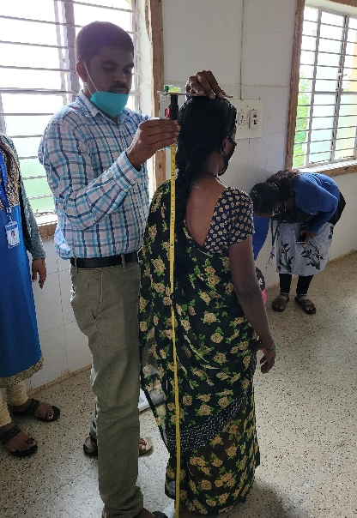
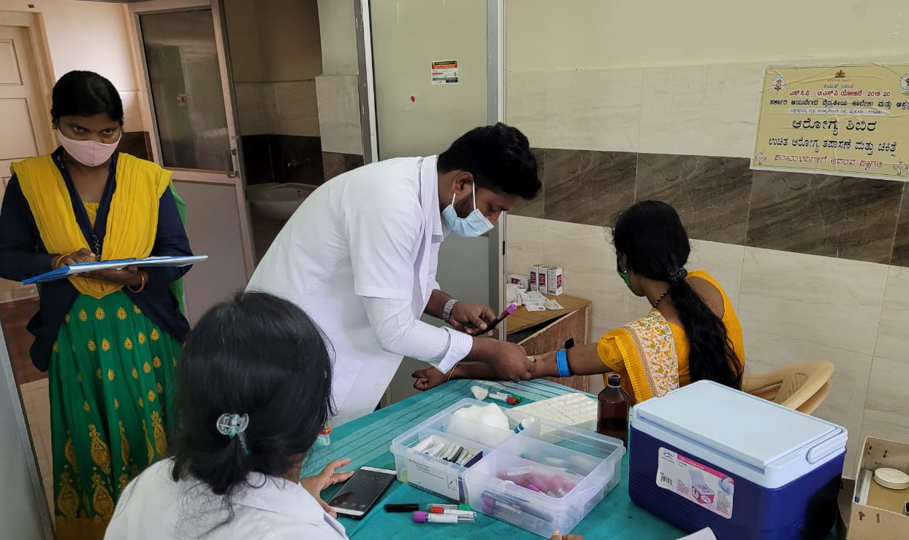
DATA COLLECTION & INTERVENTION DELIVERY
Baseline
Questionnaires 1995 (85%)
Biospecimen 1129 (~50%)
Pregnancy
Questionnaires 442 V1 (60%); 361 V2 (60%)
Biospecimen 369 V1 (50%); 249 V2 (40%)
Baby measurements:
    Birth anthropometry 235 (50%);
    Newborn DXA in ~33%
    3 mth 164 (50%)
    6 mth 89 (60%)
Interventions
>85% pre-conceptional modules;
~75% during pregnancy/early postnatal period

Slide 9
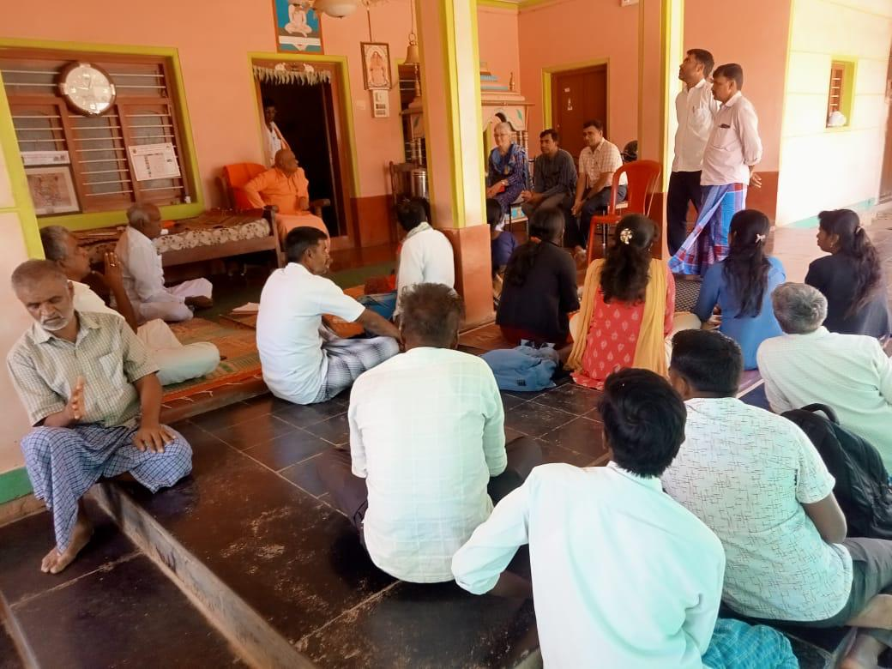
RECRUITMENT AND RETENTION STRATEGIES
Community engagement meetings
Radio station
Village fairs/events
Mobile health unit
Information leaflets
Involving families
Sensitive to socio-cultural norms incl gender
Responsive to health needs
Engagement with local actors

Slide 10
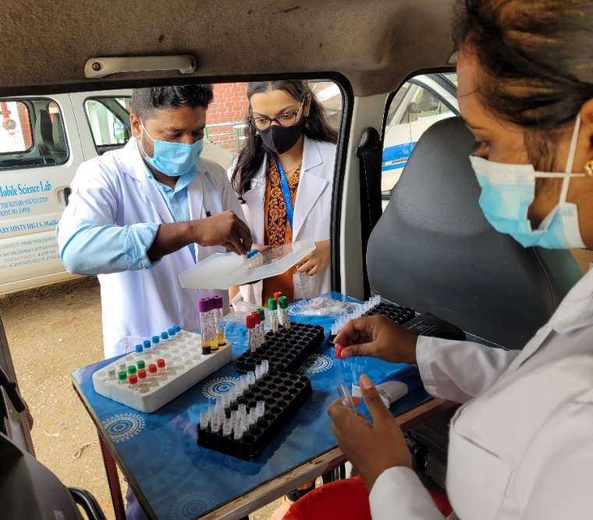
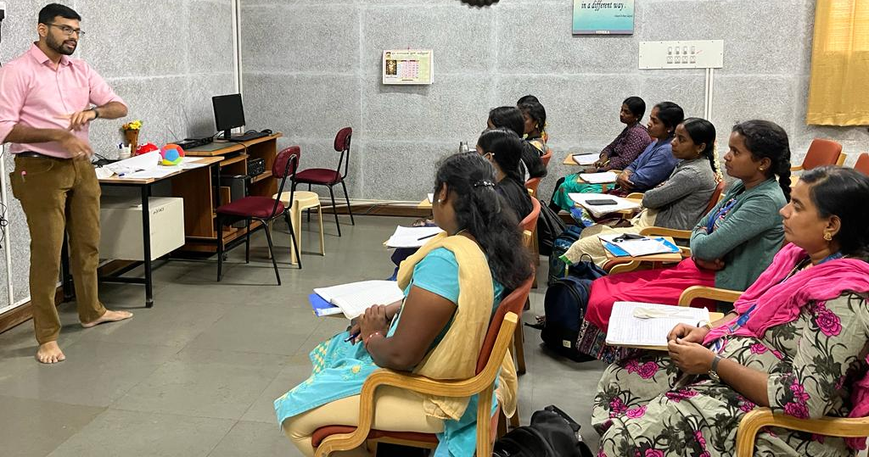
CHALLENGES
Extended recruitment period
Biorepository/biospecimen collection:
Large number of longitudinal samples
Impact if unable to collect data on time
Intervention delivery: Individual vs group
Staff turnover
Care seeking behavior
Out of area deliveries

Slide 11
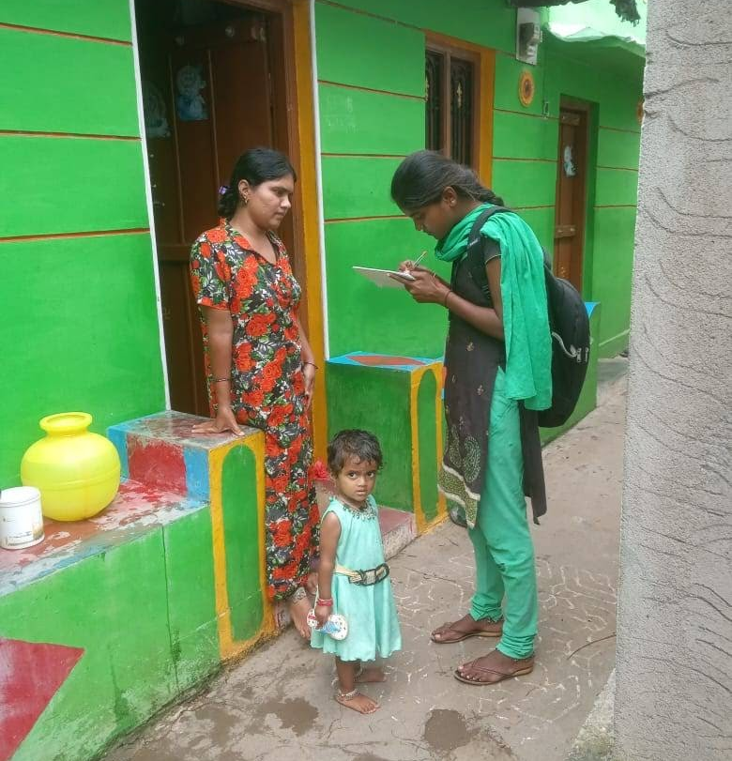
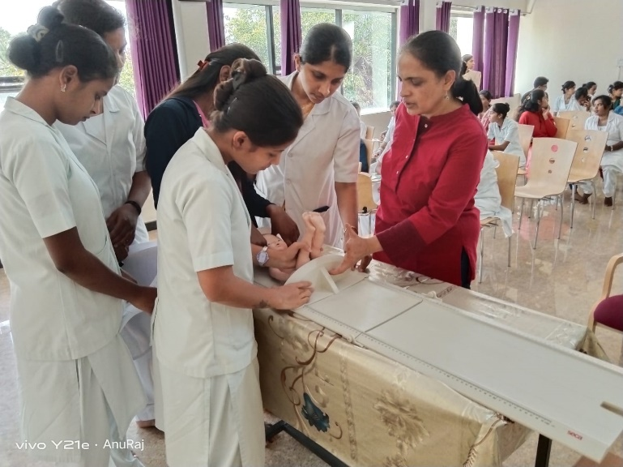
WAY FORWARD
Restarted recruitment; capacity to recruit ~400 participants per month
Mobilising resources for additional biospecimen infrastructure – mobile units
Baby measurements and pregnancy information from records (95%)
Recruited and trained additional sites
Exploring possibility of delivering intervention remotely; starting earlier

Slide 12
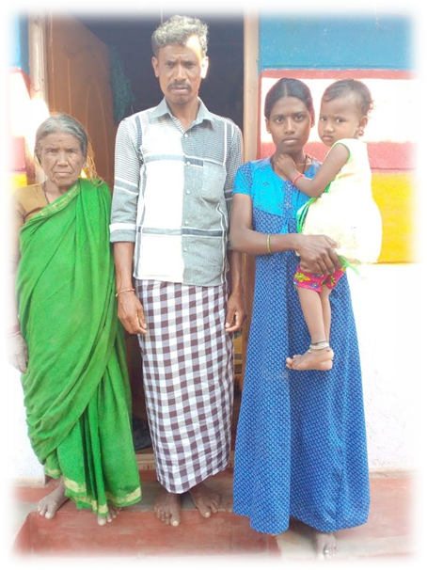
LEARNING
Developing protocols for community-based long-term multi-faceted intervention studies is complex
  Pre-conception adds to complexity
Context-specific - balance between DOHaD science and local socio-cultural context
Community engagement and local buy-in essential

Slide 13
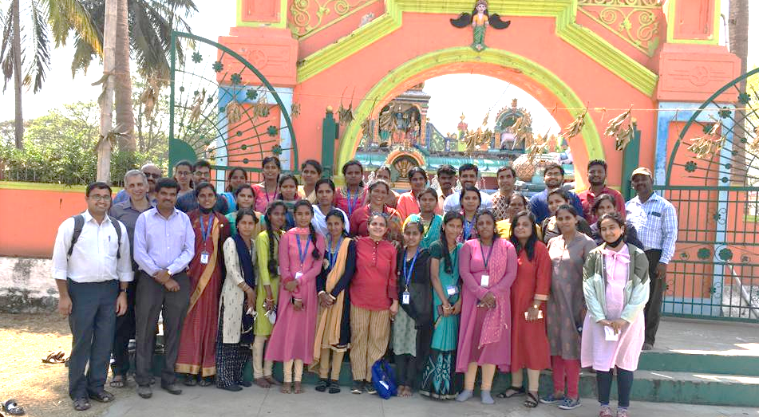

THANK YOU
Participants, Team, Funders

